Slide 1
Screening, Brief Intervention, and Referral to Treatment (SBIRT) Core Curriculum:
Referral to Treatment
The University of Iowa College of Nursing
With funding from the Substance Abuse and Mental Health Services Administration (SAMHSA)
Notes:
Welcome to the fourth module of the “Screening, Brief Intervention, and Referral to Treatment Core Curriculum.” In this module, we’ll address referral to treatment.

Slide 2
Goals for Today
Identify factors that make primary care an ideal setting for SBIRT
Identify options on the substance use care continuum
Describe practical aspects of making successful treatment referrals
Apply the SAMHSA Treatment Locator to your clinical location
Notes:
The goal of this session is to provide you with the information, tools, skills, and resources to successfully refer patients to treatment. You will learn about the various aspects of substance use treatment, including what it is and how to make a successful referral.

Slide 3

Primary Care and SBIRT
Primary care is one of the most opportune points of contact for substance use issues. Many patients are more likely to discuss
this subject with their
healthcare provider than
with a family member,
therapist, or rehab specialist.
Notes:
As we discussed at the end of Module 1, What is SBIRT and Why Use it?, primary care is an important point of contact for identifying substance use issues.

Slide 4

Primary Care and SBIRT
Given the prevalence of
substance use disorder
nationwide, it makes good
sense for primary care
practitioners – rather than
trauma centers or specialists –
to be a first line of response.
Notes:
Practitioners in primary care can be seen as a first line of response in helping people with substance use issues.

Slide 5

Primary Care and SBIRT
As discussed earlier →
Approximately 5% of patients screened will require a referral to treatment
Substance use disorder is a
chronic and relapsing illness,
so continuous monitoring
is needed
Monitoring and follow-up
in primary care is essential
Notes:
As we reviewed in Module 2, Screening for Substance Use in Clinical Settings, evidence indicates that around 5 percent of patients screened will likely require a referral to some form of specialty treatment. This is a relatively small percentage of patients, so the time commitment is not as great as you might expect.
Since substance use disorders are chronic and relapsing illnesses, continued monitoring after treatment is needed. Also, keep in mind that you may have to refer a patient to treatment more than once.

Slide 6
Primary Care and SBIRT
Address the “treatment gap”
Only ~10% with substance use disorder (SUD) receive any kind of treatment
Over 40% with SUD also have mental illness, but less than half (48%) get treatment for either
Overcome barriers, stigma, misbeliefs
Not a moral weakness or willful rejection of social norms
Deserves same level of attention as other chronic health concerns
Notes:
The Surgeon General’s Report, Facing Addiction in America, underscores important roles that primary care providers may play in addressing substance misuse and disorders.
The fact that only about 10 percent with substance use disorders receive treatment means there are critical opportunities to both make referrals and then follow up with patients to monitor and support them.
Of equal importance, providers can help break down myths and misbeliefs about substance use disorders – with patients, their families, and in the community.

Slide 7
Reasons for Hope & Optimism
Addiction to alcohol or drugs is a chronic but treatable brain disease that requires medical treatment, not moral judgment
Evidence-based treatments – both medications and behavioral therapies – can save people’s lives and restore health, well-being, and function
Notes:
While the report outlined many challenges related to alcohol and drug misuse in our country, it also made a special point of saying there are reasons for hope and optimism. These two stand out as we think about treatment. In short, effective treatment is available, but providers need to make referrals to get people the help they deserve.
_________________________________
Source: Executive Summary of “Facing Addiction in America: The Surgeon General’s Report on Alcohol, Drugs, and Health,” page ES-3

Slide 8
Substance Use Care Continuum
Enhancing Health Promoting optimum physical and mental health and well-being, free from substance misuse, through health communications and access to health care service, income and economic security, and workplace certainty. | Primary Prevention Addressing individual and environmental risk factors for substance use through evidence-based programs, policies, and strategies. | Early Intervention Screening and detecting substance use problems at an early stage and providing brief intervention as needed. | Treatment Intervening through medication, counseling, and other supportive services to eliminate symptoms and achieve and maintain sobriety, physical, spiritual and mental health, and maximum functional ability. | Recovery Support Removing barriers and providing supports to aid the long-term recovery process. Includes a range of social, educational, legal, and other services that facilitate recovery, wellness, and improved quality of life.
Notes:
In the first module, we talked about the Substance Use Status Continuum that is discussed in the Surgeon General’s Report. As you may recall, that continuum includes “positive physical, social, and mental health,” “substance misuse,” and “substance use disorder.”
As you can see, the Care Continuum, also described in the Report, articulates the varying status of substance use, from enhancing health to providing recovery support.

Slide 9
Treatment Options
Substance Use Disorder Treatment (like treatment for most other illnesses)
is designed to →
Stop or reduce major symptoms (harmful misuse)
Improve health and social function
Recognize and manage risks for relapse
Levels of care include →
Outpatient services
Intensive outpatient/Partial hospitalization services
Residential/Inpatient services
Medically-managed Intensive Inpatient services
Notes:
The Surgeon General’s Report also emphasized that substance use treatment is designed to achieve the same kinds of outcomes that we seek in other chronic disorders, and it includes four main levels of treatment.

Slide 10

Treatment Options
Counseling and other psychosocial rehabilitation services
Medications
Involvement with self-help
(AA, NA, Al-Anon)
Complementary wellness
(diet, exercise, meditation)
Combinations of the above
Notes:
In the context of those care levels, a variety of options are offered, such as counseling and other forms of psychosocial rehabilitation or the use of medications. Involvement with self-help groups or participating in wellness activities can also be considered treatment. A combination of these options is common in treatment plans.

Slide 11

Treatment Options
Level of care determined by illness severity
  Dependent or nondependent
  substance user?
  Medical or psychiatric
  comorbidities?
Outpatient often successful
Inpatient treatment
  Reserved for those with
  more serious illness
Notes:
Most patients can be successfully treated in an outpatient setting with an integrated treatment plan that might include any of the elements previously described.
For those who have a more serious illness – such as higher levels of dependence or a medical and psychiatric illness comorbidity – inpatient treatment is needed.

Slide 12

Guidelines for Greatest Success
Determine if patient is drug
or alcohol dependent and
needs medical detoxification
Nondependent substance
abusers are usually treated
as outpatients unless there are other risk factors
Most patients can be successfully served in outpatient treatment
Notes:
Here are guidelines to help you determine the best course of referral for your patients. As noted before, most patients can be referred for outpatient treatment.

Slide 13

Strong Referrals
When your patient is ready…
Make a plan with the person
Actively participate in
the referral process →
the warmer the referral
handoff, the better
the outcome!
Notes:
When your patient is ready – and readiness is important – make a plan with the person. You and/or your staff should actively participate in the referral process. The warmer the handoff, the better the outcome.
This means you should remain actively engaged in the referral process. Giving someone a business card or a list of local agencies or phone numbers has consistently failed to get people into specialty care. Your active involvement or the active involvement of one of your staff members is essential.

Slide 14
Strong Referrals
When your patient is ready…
Decide how you will interact/communicate with the treatment provider
Confirm your
follow-up plan
with the person
Decide on ongoing
follow-up support
strategies you will use
Notes:
Decide how you will interact and communicate with the specialty treatment provider. You also need to confirm your follow-up plan with your patient and decide on an ongoing follow-up strategy.

Slide 15
Strong Referrals
The “warm-handoff referral”
The clinician directly introduces the patient to the treatment provider
Purpose is to establish an initial direct contact between the patient and the treatment counselor
  Confers existing trust and rapport
  Dramatically increases success compared to passive referrals
Notes:
The referral to behavioral health care should be similar to how a clinician would refer for any other service. There should not be a discernible difference in content or tone between a referral to substance treatment and a referral to a cardiologist. Patients will pick up on the importance a provider implies regarding a referral and respond accordingly.
Here are a few examples of what you could say to a patient:
“It sounds as if you might be having many challenges right now. I work with someone who specializes in helping with these issues, and I would like you to speak with her today to better help me help you. Is it all right with you if I introduce you to her?”
Another example would be: “From our discussion today, it appears you’re open to getting further assistance to support your efforts. I have a colleague I work with who can help. His office is across town. Is it okay with you if we call and see what he has for openings? I’ll put you on speaker phone so you’re a part of the conversation.”
Another option would be to say: “Is it okay with you if my staff member assists you in setting up your first appointment?”

Slide 16

Plan for the Nuts and Bolts
Whom do you call?
Do you have access
to referral resource
information?
What form do you
fill out?
What support staff
can help?
Notes:
As you’re thinking through your referral processes, you need to determine who you will call. Is the referral resource information readily available? Is there paperwork that needs to be completed? Can any of the support staff help in the process?
Being as prepared and knowledgeable as possible really helps ease the stress for you and the person being referred.

Slide 17
Choosing a Treatment Provider
Language ability/cultural competence
Family support
Services that meet the patient’s needs
Record of keeping primary care provider informed of patient’s progress and ongoing needs
Accessible location/transportation
Notes:
It’s also important to be knowledgeable of local resources based on the composition of the population you traditionally serve. For example, the importance of language proficiency and the cultural competence of the organization may vary based on needs – but again, it’s important to know ahead of time.
In addition, you need to know if the agency that you are referring to provides family support. Also, does the facility offer services that actually meet the specific needs of the patient you are referring? Do they have a good record of keeping staff informed of patient progress and ongoing needs?
Finally, is the organization geographically accessible to your patient? What kind of transportation services are needed?

Slide 18

Payment for Services
Does the provider accept
your patient’s insurance?
Will the patient need to get
prior insurance authorization?
If the patient does not have
insurance, does the provider offer services on a sliding-fee scale?
Notes:
Payment of services is an important factor as well. Does the provider accept your patient's insurance? Will you or the patient need to get prior insurance authorization before treatment is initiated? And if the patient has no insurance, does the provider offer services on a sliding-fee scale?

Slide 19

What Should You Expect?
Substance use treatment services should provide you ongoing updates with a valid release of information
If they do not, you may
choose to refer elsewhere
(if options exist!)
Work to cultivate
partnerships
Notes:
Substance use treatment facilities and services should provide you with ongoing updates once a valid release of information has been signed. If they do not, you should consider referring your patient to another treatment facility.
The caveat in rural settings is that other options may be sparse, so working to develop relationships that advance patient care outcomes may be more important than in urban settings.

Slide 20

What Should You Expect?
Substance use treatment
facilities should provide
you with a structured
discharge plan discussing →
  Ongoing treatment needs
  Recovery needs
  Sources of assistance
  Recommended providers
Notes:
Substance use facilities should provide you with a structured discharge plan following completion of treatment and discuss the patient’s ongoing treatment and recovery needs. They should also provide specific recommendations as to what interventions the patient might access and where they should go for those interventions.

Slide 21

What Should You Expect?
Programs change over time
Maintain an up-to-date roster
  Public and private
  treatment
  Self-help resources
  in your community
Notes:
Since programs change over time, it’s important that you maintain an up-to-date list of treatment facilities and self-help resources in your community. As we’ll discuss in a minute, the SAMHSA National Treatment Facility Locator provides considerable support.

Slide 22

Common Mistakes to Avoid
Rushing into “action” and making a
treatment referral when the patient
isn’t interested or ready
Referring to a program that is full or
does not take the patient’s insurance
Not knowing your referral base
Not considering pharmacotherapy in support of treatment and recovery
Seeing the patient as “resistant” or “self-sabotaging” instead of having a chronic disease
Notes:
As you think about making a referral, work to avoid common mistakes.
The first and probably most common mistake is rushing into action and making a referral when the patient either is not ready or is not interested. Second, referring to an agency that is overfilled or a program that doesn’t take the patient’s insurance is frustrating for both you and your patient.
A third mistake is not knowing what your referral base is in your own community. The fourth mistake occurs too frequently. Some clinicians don’t consider the appropriate use of pharmacotherapies in support of treatment and recovery. Specifically, for alcohol dependence and opioid dependence, there are proven and effective medications that help with the recovery process.
Finally, we get frustrated. We start to see our patients as resistant or self‑sabotaging instead of remembering and recognizing that they have a difficult and chronic disease.

Slide 23



Referral Resources
SAMHSA’s National Treatment Facility Locator http://findtreatment.samhsa.gov
Notes:
The Substance Abuse and Mental Health Services Administration maintains a national database for treatment facilities. All 50 states and 4 territories are listed on it. We highly recommend that you see what resources are available in your community, and also share them with others in your clinic or practice.

Slide 24
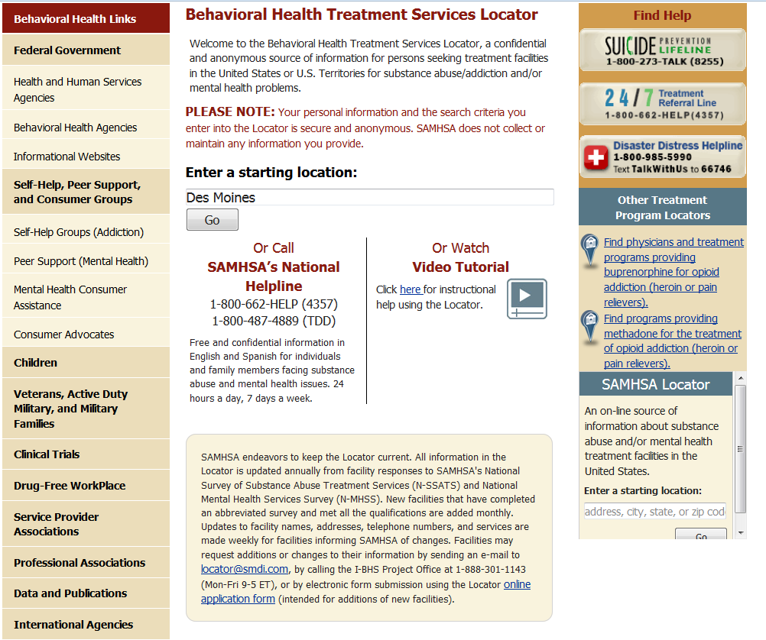
Notes:
Here is a screen shot of the page that you’ll see when you use the link on the previous slide. For example, we typed in Des Moines to see what kind of services are available in and around the area.

Slide 25
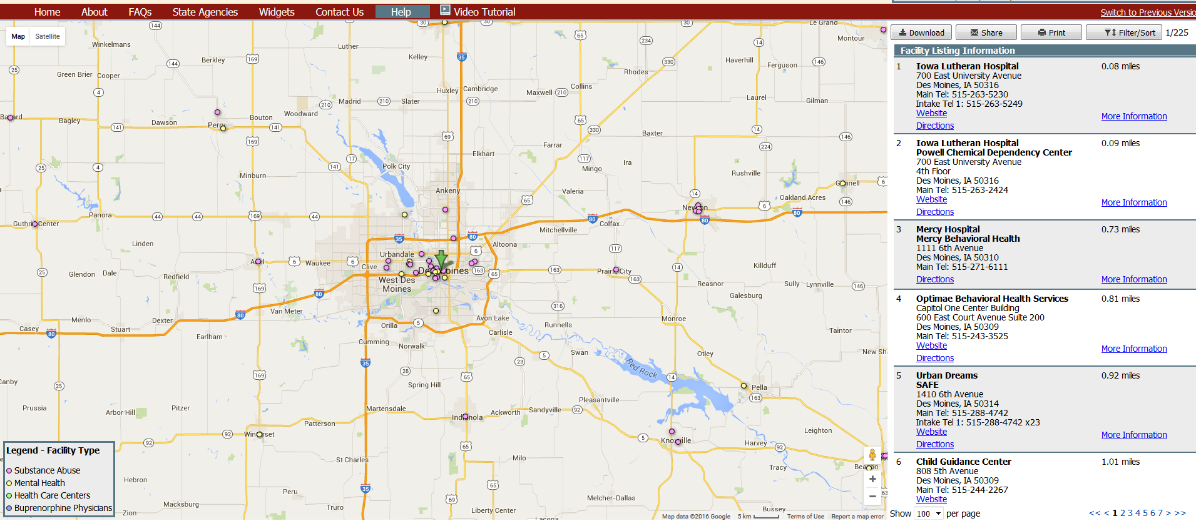
Des Moines…
Resources → Name, Location, Phone, Directions, More Information
Map → Visualize the location in relationship to your client
But this is just the starting point! Calling in advance is often critical to success!!!
Notes:
Note that the locator offers a map so you can visualize the locations, and it also provides detailed information about the name, location, and services offered.
As before, we highly recommend getting in touch with the service ahead of time to see how their program may fit the needs of the clients that you commonly serve. Having a “key contact” person in the agency can help with problem-solving when you need to refer.

Slide 26
Back to the SBIRT Process…
Statistically speaking…
Many prescreens are negative; few full screens needed
Even with full screen, many are low risk
Being READY is the key!
Brief intervention → Feeling comfortable following the guide/having the conversation
Referral to treatment → Knowing who/where/what is available; warm handoff
Notes:
In summary, the primary focus of SBIRT is on identifying those who need help to reduce risks of harm. Most of the screening done in primary care settings involves the Brief Negotiated Interview, not referrals to treatment. However, an estimated 5 percent of those screened will be in the harmful or dependent range that indicates making a referral to treatment.
As we discussed today, one of the biggest mistakes is to “rush to referral” – meaning the person isn’t ready. But when the person is ready, being prepared and using the warm handoff approach can increase success.

Slide 27

Summary
Treatment works
With a minimal amount of
preparation, you can know what
is available in your community
Clarify your procedures for
referral
Warm handoffs work best
Follow up!
Notes:
As before, success relies on believing in treatment, and also believing that people with substance use disorders deserve the same level of attention and care as others with chronic medical disorders. How providers make referrals really does matter!
It’s also important to follow up with your patient to confirm that they went to their treatment location. What was their experience? Did they have questions? Did they have concerns? Your monitoring and follow-up become part of the important structure that supports them on their sometimes difficult journey.
This is the conclusion of our four-module SBIRT Core Curriculum.

Slide 28
Acknowledgements
Content in this educational module was provided by the Substance Abuse and Mental Health Services Administration (SAMHSA) under grant to the University of Iowa with permission to adapt and use in training.
Grant #1H79TI025939-01
Notes:
Thank you to our funding agency for supporting this program.

Slide 29



Acknowledgements

