Slide 1
Screening, Brief Intervention, and Referral to Treatment (SBIRT) Core Curriculum: Screening for Substance Use in Clinical Settings
The University of Iowa College of Nursing
With funding from the Substance Abuse and Mental Health Services Administration (SAMHSA)
Notes:
Welcome to the second module of the “Screening, Brief Intervention, and Referral to Treatment Core Curriculum.” In this module, we’ll address screening patients for substance use in a clinical setting.

Slide 2
Goals for Today
Understand universal screening
Identify substance use risk limits
Describe SBIRT screening steps, including prescreening and screening
Discuss how to use two screening tools
Describe how screening informs brief interventions
Notes:
The goal of this session is to provide you with the information, tools, skills, and resources to successfully screen patients. You will learn how this is done within a clinical setting and will be oriented to the use of brief and valid substance use screening tools.

Slide 3
SBIRT in Clinical Settings
Annual 2-Question Prescreen
Annual 2-item screen (<1 min), followed by the full screen ONLY if indicated! Full screen (3-5 min) doesn’t take much time!
Negative:
Stop
Positive:
Full AUDIT or DAST-10
☑ Education Sheet
Low Risk:
☑ Positive Reinforcement
Risky:
☑ Brief Intervention
Harmful or Dependent:
☑ Brief Intervention
☑ Referral
Notes:
Let’s start by looking at the SBIRT prescreening process. It’s important to acknowledge that there are several ways to prescreen. For this program, we use the annual 2-question prescreen, which is also called a universal screen. We’ll address these two questions in more detail shortly.
This flow chart illustrates how the annual prescreen is used to detect individuals who may be at risk for substance misuse. The Alcohol Use Disorders Identification Test, or AUDIT, and the Drug Abuse Screening Test, or DAST, are only used if the person is positive on the prescreen.

Slide 4
Why Screen Universally?
Normalize clinician/patient conversations
Detect alcohol and substance use patterns that can increase future injury or illness risks
Why are you asking me about alcohol and drug use?! Do I look like I have issues, or what?!
We screen everyone that comes through the door. It’s part of our prevention and wellness approach to health care.
Notes:
The annual 2-question prescreening process, or universal screening, normalizes clinician/patient conversations regarding substance use, and can be a significant step toward early detection and effective intervention.

Slide 5
Why Screen Universally?
The clinician is often the first point of contact
Patients are often seen by a clinician because of a related physical problem
Early identification and intervention lead to better outcomes
People are more open to change than you might expect
Notes:
As we discussed in the first module, there are many good reasons to screen for substance misuse in primary care settings. The 2-item screening is an important first step toward making changes to enhance health.
__________________________________
Source: Treatnet. (2008). Screening, assessment and treatment planning. Retrieved from http://www.unodc.org/ddt-training/treatment/a.html

Slide 6
Prescreening Results
Negative
Based on previous experiences with SBIRT, 75% of prescreens are NEGATIVE
Positive
About 20% to 25% are POSITIVE, indicating you use the AUDIT, DAST, or both
Notes:
On average in primary care settings, 20 to 25 percent of individuals screen positive, and the rest are negative. Other settings, such as HIV/AIDS counseling and testing sites or mental health clinics, often have higher rates of positive screens.

Slide 7
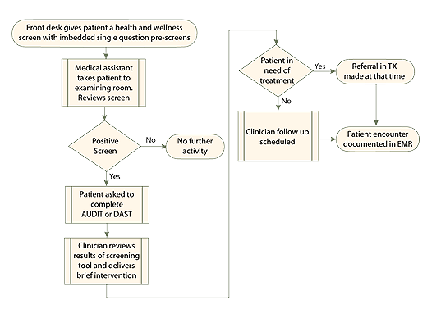
Screening in a Clinical Setting
Most settings use a team approach. Different steps can be done by different individuals and achieve the same outcomes!
Notes:
This is another way to think about using the annual prescreen in your clinical practice. In most primary care settings, consistent and effective use of the SBIRT process is a team approach.

Slide 8
When Screening, Remember To…
Engage the patient and build rapport
Describe your role
Orient the patient to the screening process
Ask questions as they are written, clarify any ambiguities, and allow the patient to answer questions independently
Notes:
Drinking or drug use can be a sensitive subject. That’s why it’s important for the clinician to build rapport with the patient, describe their role in the screening process, explain the process to the patient, and address questions effectively.

Slide 9
UI-branded copy of the annual (prescreening) form
Note: the alcohol question depends on age and sex
Pocket Card
Notes:
This is the Annual Questionnaire that we are using in this program at the University of Iowa. It’s available to students, their preceptors, and others who are interested in using SBIRT in clinical settings.
This screening uses an episode of binge drinking as the “trigger” for using the AUDIT. Our question is simply, “How many times in the past year have you had 5 or more drinks in a day?” As you can see, 5 in a day is for men, and we use 4 in a day for women and older adults.

Slide 10
Prescreening Approaches: Alcohol
Another way to prescreen…
Any alcohol use: Yes/No
“Do you sometimes drink beer, wine, or other alcoholic beverages?”
If YES, then ask:
“How many times in the past year have you had X or more drinks in a day?”
[X = 5 for men, 4 for women and those over 65]
Notes:
Another approach is to ask if the person uses alcohol at all – a simple yes/no question. If the answer is “yes,” you ask the question about binge drinking that we adopted for our training.

Slide 11
Prescreening Approaches: Alcohol
Guidelines…
Use per day/week using health limits
Men ≤ 65 years: 2 drinks/day; 14 drinks/week
Women: 1 drink/day; 7 drinks/week
Anyone > 65: 1 drink/day; 7 drinks/week
Excessive/binge drinking
More than 4 on an occasion for men ≤ 65 years
More than 3 on an occasion for women and those > 65 years
Notes:
Even when we screen clients on their first visit and then annually, we also need to listen carefully in between for comments or reports that suggest screening may be needed to assess level of risk.
The guidelines outlined on the slide related to use per day and week are recommendations for healthy drinking. As discussed before, binge drinking is defined as the number of drinks on a single occasion. As we’ll see in a minute, one occasion of heavy drinking, like a wedding or other special event, isn’t the issue. We’re looking for patterns that suggest risk for negative outcomes.

Slide 12
Clarify What One Drink Is!
Notes:
As we talk about number of drinks in a day, it’s important to clarify what we mean by “one drink.”

Slide 13
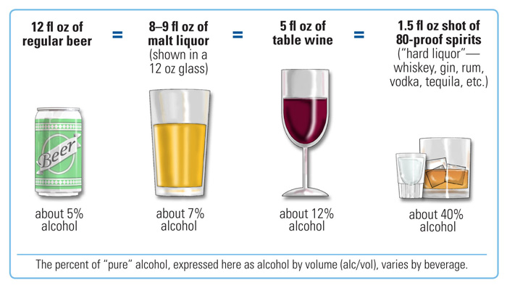
What is “A Drink”?
Pocket Card
National Institute on Alcohol Abuse and Alcoholism. (2013). What is a standard drink? Retrieved from http://www.niaaa.nih.gov/alcohol-health/overview-alcohol-consumption/standard-drink
Notes:
A standard drink is defined as 5 ounces of wine, 12 ounces of beer, or 1.5 ounces of spirits. All have an equivalent amount of alcohol, which is 14 grams.
__________________________________________
National Institute on Alcohol Abuse and Alcoholism. (2013). What is a standard drink? Retrieved from http://www.niaaa.nih.gov/alcohol-health/overview-alcohol-consumption/standard-drink

Slide 14
SBIRT in Clinical Settings
Annual 2-Question Prescreen
Use the AUDIT if the answer is one or more to the alcohol prescreening question: “How many times in the past year have you had X or more drinks in a day?”
Negative:
Stop
Positive:
Full AUDIT or DAST-10
☑ Education Sheet
Low Risk:
☑ Positive Reinforcement
Risky:
☑ Brief Intervention
Harmful or Dependent:
☑ Brief Intervention
☑ Referral
Pocket Card
Notes:
If the person responds positively to the prescreening question about alcohol – meaning their answer is one or more days – then the next step is to use the AUDIT.

Slide 15
AUDIT
Alcohol Use Disorders Identification Test
Public domain tool developed by the World Health Organization (WHO)
Validated for use in primary care, other settings
For alcohol screening only
Ten questions
Simple and straightforward
Easy to administer
Notes:
The AUDIT is a public domain tool that was created by the World Health Organization and has been translated into numerous languages, including Spanish. It is validated for use in many settings, including primary care.
The scale addresses recent alcohol use, alcohol dependence symptoms, and alcohol-related problems. This 10-question tool is simple and straightforward to use and can be self‑scored by the patient or administered by a worker. It can also be embedded into a tablet or an electronic health record.

Slide 16
UI-branded copy of the AUDIT form
This is available on our website clearinghouse: www.uiowa.edu/sbirt/
Pocket Card
Notes:
Here is an example of what the AUDIT looks like. The University of Iowa format does not include the scoring information on the form itself, so it can be given to the person for self-rating. The options in the columns are scored consistently for all 10 items, from 0 to 4. The far left column is 0 and the far right column is 4. To get the total score, we sum each column and then add the 4 column scores together.

Slide 17
AUDIT Domains
Hazardous Alcohol Use
Q1: Frequency drinking
Q2: Typical quantity
Q3: Frequency heavy drinking
Dependence Symptoms
Q4: Impaired control over drinking
Q5: Increased salience of drinking
Q6: Morning drinking
Harmful Alcohol Use
Q7: Guilt after drinking
Q8: Blackouts
Q9: Alcohol-related injuries
Q10: Others concerned about drinking
Notes:
Although this doesn’t relate to scoring the AUDIT, it’s interesting to know that the 10 questions are divided into 3 domains that address different levels of behavior.
______________________________
WHO, 1992.

Slide 18
UI-branded copy of scoring information
This is available on our website clearinghouse: www.uiowa.edu/sbirt/
Pocket Card
Notes:
We are using a single Scoring Tool for both the AUDIT and the DAST. The total score on the AUDIT determines what step clinicians take next.

Slide 19
AUDIT Scoring Directs Next Steps
0 to 7 = Negative, Low Risk: No intervention needed
8 to 15 = Risky drinking: Use the Brief Intervention
16 or greater = Harmful or dependent: Refer to treatment (if willing)
10 items scored 0 to 4 for a total possible score of 0 to 40
Next steps depend on:
AUDIT score
The PERSON and your relationship!
Availability of treatment: accessibility, acceptability!
ASK permission to talk about the score and options!
Notes:
As shown, individuals who score in the 0 to 7 range are considered LOW risk, and no further intervention is needed – although giving the person positive reinforcement for being in the “healthy drinking” range is a good idea.
Scores of 8 to 15 are considered RISKY drinking that indicate using the Brief Intervention. Scores of 16 or higher signify harmful or dependent levels of drinking that indicate the clinician should use the Brief Intervention, but should also explore referral to specialty treatment with the person.

Slide 20
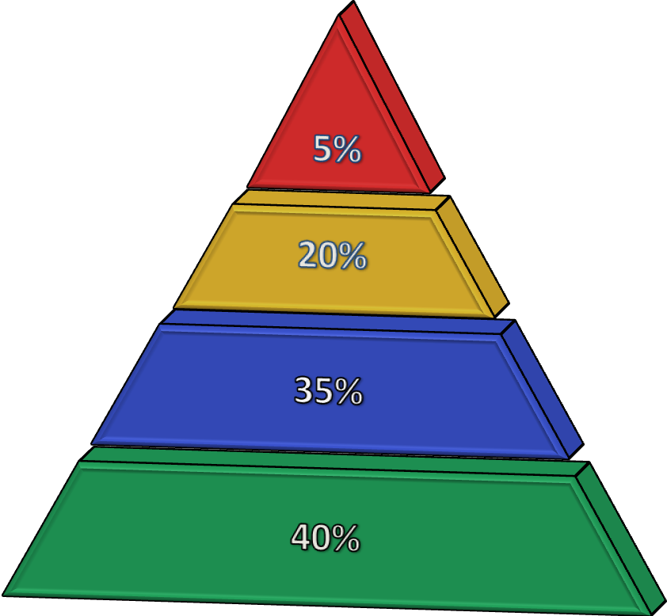
AUDIT Outcomes
Dependent Use (20+)
Harmful Use (16‒19)
At-Risk Use (8‒15)
Low Risk (0‒7)
Commonly reported frequencies using large samples of the population
Notes:
By way of example, about 40 percent of those screened using the AUDIT are in the low risk range. Thirty-five percent demonstrate some level of risk with their use, 20 percent are at harmful levels of use, and 5 percent score at the dependent level.

Slide 21
Learning Exercise
5 oz of wine = 1 oz of spirits = 12 oz of beer
Is this True or False?
True
False
Notes:
Let’s look at a question about standard drink size.
Is the following statement true or false?
Five ounces of wine equals one ounce of spirits and equals 12 ounces of beer.

Slide 22
Learning Exercise
5 oz of wine = 1 oz of spirits = 12 oz of beer
Is this True or False?
True
False
Notes:
This is false. Five ounces of wine and 12 ounces of beer equal a standard drink size, but it takes 1.5 ounces of spirits to equal a standard drink.

Slide 23
Screening for Drugs and Using the DAST-10
Notes:
Now let’s look at information on drug screening and a commonly-used screening tool.

Slide 24
UI-branded copy of the annual (prescreening) form
Illicit drug use, but also use of prescription drugs for non-medical purpose!
Pocket Card
Notes:
The second question in our annual 2-question prescreening questionnaire is related to drug use. It asks, “How many times in the past year have you used an illegal drug, or used a prescription medication for NON-medical purposes?”

Slide 25
Prescription Drug Misuse
Many people take medications that are not prescribed to them (“borrow” meds), or don’t take their prescription drugs “as prescribed”
SBIRT is primarily concerned with “recreational use” (non-medical purpose)
Opioids
Benzodiazepines
Depressants
Stimulants
Notes:
As clinicians, you are likely concerned about misuse of medications in general, like borrowing pills from a family member or friend, and not taking prescription drugs as prescribed – whether that’s taking too much, or too little, or taking medications for the wrong reasons. But SBIRT is really concerned with the use of prescription drugs for NON-medical, or recreational use. Some of the most common categories used recreationally are listed on the slide.

Slide 26
DAST-10
Drug Abuse Screening Test (10-item)
Public domain tool developed by the Addiction Research Foundation
Sensitive screening tool for at-risk drug use (not alcohol)
Quantitative index of problems related to drug misuse
Ten questions
Simple and straightforward
Easy to administer
Notes:
The 10-item DAST scale is recommended for screening for at-risk drug use. It is a public domain tool that was originally developed by the Addiction Research Foundation, now part of the Centre for Addiction and Mental Health in Canada. It has two forms, with the DAST-10 being a condensed version of the original DAST-28.

Slide 27
UI-branded copy of the DAST-10
This is available on our website clearinghouse: www.uiowa.edu/sbirt/
Pocket Card
Notes:
This is the University of Iowa-branded copy of the 10-item DAST that we are providing to students, their preceptors, and others who are interested in using SBIRT in practice. Like the AUDIT, we have taken the scoring information off the form so the person can self-administer the scale. Note that “Yes” is scored 1 point for all items except number 3, “Are you always able to stop using drugs when you want to?” For this question, “Yes” is scored as 0 and “No” is scored as 1.

Slide 28
DAST-10 Scoring Directs Next Steps
0 = No Risk: No action needed
1 to 2 = Low level “At Risk”: Brief Intervention; monitor and reassess later
3 to 5 = Moderate level “At Risk”: Brief Intervention or refer to treatment
6 to 10 = Substantial level “High Risk”: Refer to treatment
10 items scored; YES = 1 and NO = 0, except item 3, for a total score of 0 to 10
Next steps depend on:
DAST score
The PERSON
Availability of treatment: accessibility, acceptability
Most treatment is outpatient; inpatient for severe risk
Notes:
The total score is just the sum of the positive answers, remembering that item number 3 is reverse-scored. Like the AUDIT, we use the total score to decide next steps. Given that the DAST follows a positive prescreen, scores will range from 1 to 10.
Scores of 1 to 2 are considered low-level risk that is best addressed with the Brief Intervention. Scores of 3 to 5 also indicate using the Brief Intervention, but suggest referral might be needed as well. Scores of 6 to 10 are considered high risk-use that is best addressed in specialty treatment, so referral is the next best step. However, next steps depend on the person AND the availability and acceptability of treatment – which we’ll talk about again in a later module.

Slide 29
UI-branded copy of scoring information
This is available on our website clearinghouse: www.uiowa.edu/sbirt/
Pocket Card
Notes:
As before, our Scoring Tool includes cut-points for both the AUDIT and the DAST.

Slide 30
DAST-10 Outcomes
Substantial Level (6+)
Moderate Level (3‒5)
Low Level (1‒2)
Abstainers (0)
Commonly reported frequencies using large samples of the population
Notes:
About 40 percent of persons report no use of illicit drugs, or recreational use of prescription drugs. About 35 percent score at the “low level” and 20 percent score at the moderate level – both of which indicate using the Brief Intervention. Of importance, less than 5 percent of the population are viewed as being at substantial risk that requires intensive treatment.

Slide 31
Impact of Screening
Screening is the first step of the SBIRT process and determines the severity and risk level of the patient’s substance use
The result of a screening allows the provider to determine if a Brief Intervention or a referral to treatment is a necessary next step for the patient
Notes:
In the SBIRT process, the first step is screening. Based on the results of the screening, you can determine if further action is necessary.

Slide 32
Impact of Screening
Screening and related discussion provide valid, patient self-reported information that is used in Brief Intervention AND health care/treatment
Screening process often sets in motion patient reflection on their substance use behavior
Notes:
One of the benefits of screening is that it provides the clinician with valid, patient-reported information that can guide both “next steps” related to substance use, and also overall health care and treatment of other conditions.
In addition, the process of screening often stimulates the person to think, consider, and reflect on his or her substance use behavior. As discussed in Motivational Interviewing, this reflection can support readiness to change toward more healthy habits.

Slide 33
Key Points for Screening
Screen everyone!
Screen both alcohol and drug use, including prescription drugs
Incorporate prescreening with other health and wellness surveys, if possible
Explore each substance; many patients use more than one
Use nonjudgmental, empathic verbal and nonverbal behaviors
Notes:
The key points to remember about screening for alcohol and drug use are listed on this slide. One of the most important is that everyone should be screened.
Throughout screening, using principles and skills of Motivational Interviewing (like being non-judgmental and empathetic) will increase the likelihood of having successful, productive conversations about the individual’s substance use.

Slide 34
Screening Informs the SBIRT Intervention
Notes:
The full alcohol and drug screens stratify patient risk levels into zones of use. These zones inform the type of intervention to be delivered.
Low-risk users receive screening and feedback only. Risky and harmful users receive Brief Intervention and possibly referral to treatment. Persons at severe and dependent ranges are referred for further assessment and specialty care.

Slide 35
What’s Next? SBIRT
The Brief Intervention
A semi-structured interview process based on Motivational Interviewing that is an evidence-based practice and can be completed in 5−15 minutes
Notes:
In the next session, you will learn about the Brief Intervention.

Slide 36
Acknowledgements
Content in this educational module was provided by the Substance Abuse and Mental Health Services Administration (SAMHSA) under grant to the University of Iowa with permission to adapt and use in training.
Grant #1H79TI025939-01
Notes:
Thank you to our funding agency for supporting this program.

Slide 37
Acknowledgements

