Slide 1
Screening, Brief Intervention, and Referral to Treatment (SBIRT) Core Curriculum: What is SBIRT and Why Use It?
The University of Iowa College of Nursing
With funding from the Substance Abuse and Mental Health Services Administration (SAMHSA)
Notes:
Welcome to the “Screening, Brief Intervention, and Referral to Treatment Core Curriculum.” This is the first of four modules that you will be taking about SBIRT.

Slide 2
SBIRT at the University of Iowa
Screening, Brief Intervention, and Referral to Treatment – Training Iowa Preceptors and Students (SBIRT-TIPS)
Sponsored by the University of Iowa College of Nursing in collaboration with the Carver College of Medicine Physician Assistant program
Funded by the Substance Abuse and Mental Health Services Administration (SAMHSA)
Notes:
SBIRT training is being offered at the University of Iowa with funding from the Substance Abuse and Mental Health Services Administration.

Slide 3
SBIRT at the University of Iowa
The 3-year project has 2 main goals:
To educate doctor of nursing practice (DNP) and physician assistant (PA) students on applying SBIRT in clinical practice
To promote adoption of SBIRT as “standard of care” by health systems, settings, and practitioners in cooperation with SBIRT Iowa, the statewide initiative
Notes:
Our three-year project has two main goals. One is to train students to apply SBIRT. A second goal is to help them develop the skills necessary to apply this preventative health measure in clinical practice settings during their education and after they graduate.

Slide 4
Core Curriculum Modules
What Is SBIRT and Why Use It?
Screening for Substance Use Disorders
Brief Intervention
Referral to Treatment
All based on Motivational Interviewing skills!
Notes:
There are four main modules in what we call the “core” training for SBIRT. Motivational Interviewing skills are the foundation for using SBIRT. In our training program, we offer Motivational Interviewing content as a separate sequence of modules that are completed before we review the SBIRT training.

Slide 5
What is SBIRT and Why Use It?
Notes:
So in this first module, we’ll discuss what SBIRT is and why it’s important.

Slide 6
What is SBIRT?
An intervention based on Motivational Interviewing strategies
Screening: Universal screening for quickly assessing use and severity of alcohol; illicit drugs; and prescription drug use, misuse, and abuse
Brief Intervention: Brief motivational and awareness-raising intervention given to risky or problematic substance users
Referral to Treatment: Referrals to specialty care for patients with substance use disorder
Notes:
SBIRT stands for Screening, Brief Intervention, and Referral to Treatment. The SBIRT model is based on motivational interviewing. In subsequent modules, we’ll talk about each of these three main components in more detail. For now, we’d like to emphasize how important it is to understand and use the model in clinical care.

Slide 7
Goals for Today
Identify key issues in the 2016 Surgeon General’s report
Describe the substance use continuum
Define SBIRT
Review key evidence supporting SBIRT use
Describe potential SBIRT-related outcomes
Notes:
Our main goals for today are to consider the underlying issues that SBIRT addresses, talk about how SBIRT fits into the continuum of substance use, and briefly review evidence that supports its use in practice.

Slide 8
Facing Addiction in America
Drug and alcohol misuse and disorders are a public health challenge that affect millions and place enormous burdens on society
The U.S. has a serious substance misuse problem and is facing an unprecedented opioid epidemic
Notes:
An important starting point is the report, Facing Addiction in America: The Surgeon General’s Report on Alcohol, Drugs, and Health. Vivek Murthy, who created this report in 2016 while Surgeon General for the U.S. Public Health Service, brought the nation’s attention to substance misuse and abuse.
_______________________
Source: Slide deck from January 30, 2017 presentation to SAMHSA Grantee by V. Murthy & K. Enomoto.

Slide 9
Surgeon General’s Report
Among the U.S. population aged 12 or older →
Over 66 million report binge drinking [# drinks on one occasion: >5 men; >4 women]
Over 47 million used an illicit or non-prescribed drug
Almost 21 million met the criteria for Substance Use Disorder
Notes:
Substance use issues in the U.S. are a large and growing problem, and it’s the main driving factor for prevention programs like SBIRT.
_______________________
Source: Slide deck from January 30, 2017 presentation to SAMHSA Grantee by V. Murthy & K. Enomoto.

Slide 10
Surgeon General’s Report
We can reduce substance misuse and addiction: Prevention works, treatment is effective, recovery is possible for everyone
There is a clear precedent: The 1964 Surgeon General’s Report on Smoking and Health
Notes:
While there are lots of challenges, there is also a lot of optimism about reducing misuse and addiction – including use of programs like SBIRT to prevent substance use disorders.
_______________________
Source: Slide deck from January 30, 2017 presentation to SAMHSA Grantee by V. Murthy & K. Enomoto.

Slide 11
Surgeon General’s Report
Use – Any use of substance
Misuse – Use that can harm the person or others; also called “risky, at risk, harmful”
Substance Use Disorder – Medical illness, often chronic; also called “substance dependence, addiction”
Notes:
As the report notes, an important starting point is to understand the difference between “misuse” and “substance use disorder,” which is more commonly known as addiction or dependence.

Slide 12
Substance Use Status Continuum
Positive Physical, Social and Mental Health A state of physical, mental and social well-being, free from substance misuse, in which an individual is able to realize his or her abilities, cope with normal stresses of life, work productively and fruitfully, and make a contribution to his or her community. | Substance Misuse The use of any substance in a manner, situation, amount, or frequency that can cause harm to the user and/or those around them. | Substance Use Disorder Clinically and functionally significant impairment caused by substance use, including health problems, disability, and failure to meet major responsibilities at work, school, or home; substance use disorder is measured on a continuum from mild, moderate, to severe based on a person’s number of symptoms.
Notes:
Although this slide is busy, the descriptions in the Surgeon General’s report provide an important perspective on the continuum of substance use status.

Slide 13
Hazardous Substance Use
Increased risk for:
Injury/trauma
Criminal justice involvement
Social problems
Mental health consequences (e.g., anxiety, depression)
Increased absenteeism and accidents in the workplace
Notes:
As outlined on the slide, there is a long list of potential risks associated with hazardous substance use, which, in turn, makes it an important clinical issue to address.

Slide 14
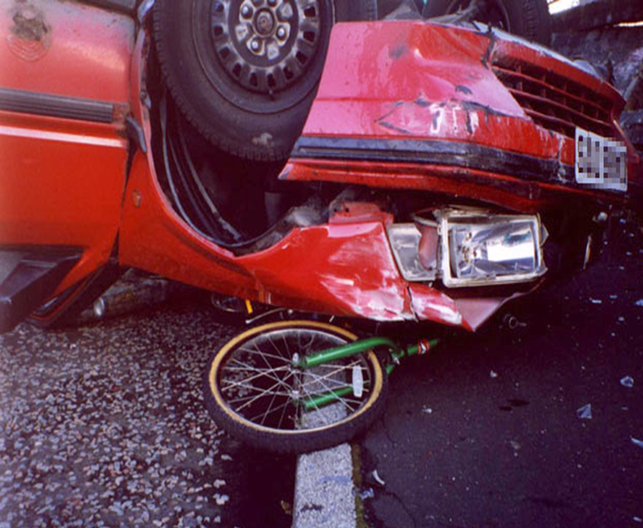
Hazardous Substance Use
Notes:
Accidents are a leading risk related to “substance misuse” and “substance use disorders,” including not only those associated with driving under the influence, but other accidents and injuries as well.

Slide 15
Hazardous Substance Use
Notes:
The medical and psychiatric consequences of high-risk drinking are also well documented. Nearly all systems of the body can be adversely affected by risky or dependent levels of drinking. Growing evidence also points to the health consequences of drug misuse and abuse.

Slide 16
Hazardous Substance Use
Notes:
The risk of experiencing negative personal, social, and economic effects is also considerably higher for both moderate and higher-risk drinkers compared to those who are light drinkers. The evidence indicates that moderate-risk and high-risk drinkers account for the most problems.

Slide 17
The Traditional Model: A Continuum of Substance Use
Abstinence
Responsible Use
Addiction
Notes:
Let’s go back to definitions of “substance use” and “substance use disorders” and think some more about SBIRT in practice.
This graphic represents the traditional continuum, which really only recognizes abstinence and “responsible use” and addiction. You either have a problem or you don’t.

Slide 18
The SBIRT Model: A Continuum of Substance Use
Experimental Use
Social Use
Binge Use
Abstinence
Harmful
Misuse
Substance Use Disorder
Notes:
What we understand today is that the continuum includes misuse or high risk use – substance use that is potentially harmful to the person.

Slide 19
If This is the U.S. Population…
Concept developed by Daniel Hungerford, PhD, Centers for Disease Control and Prevention (Used with Permission).
Notes:
Looking at it another way, consider the dots as the total adult population in the U.S.
_______________________
Reference: World Health Organization Brief Intervention for Hazardous and Harmful Drinking; Thomas F. Babor and John C. Higgins-Biddle, 2001.

Slide 20
This is Substance Use Disorder:
Concept developed by Daniel Hungerford, PhD, Centers for Disease Control and Prevention (Used with Permission).
Notes:
A reasonably small number (roughly 5 percent) have a diagnosable substance use disorder.
_______________________
Reference: World Health Organization Brief Intervention for Hazardous and Harmful Drinking; Thomas F. Babor and John C. Higgins-Biddle, 2001.

Slide 21
And This is Harmful Use:
Concept developed by Daniel Hungerford, PhD, Centers for Disease Control and Prevention (Used with Permission).
Notes:
A considerably larger number (approximately 20 percent) are misusing – meaning they are in that risky, harmful range that SBIRT targets.
_______________________
Reference: World Health Organization Brief Intervention for Hazardous and Harmful Drinking; Thomas F. Babor and John C. Higgins-Biddle, 2001.

Slide 22
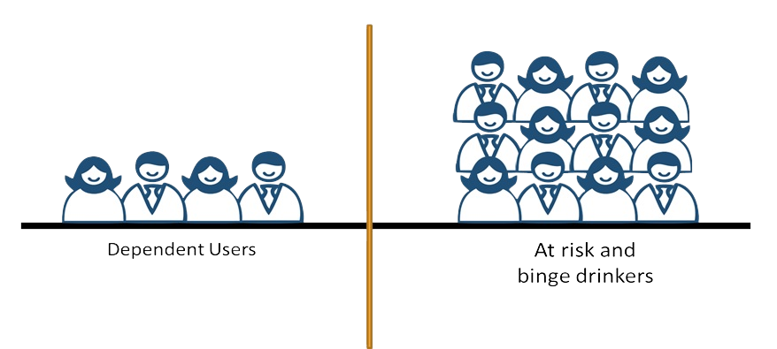
SBIRT Goal
Referral to Treatment
Brief Intervention
Notes:
SBIRT focuses on identifying individuals who are at risk for harm. The primary focus is on providing brief interventions to those who misuse and making referrals to specialty treatment for those who are at even higher risk.

Slide 23
SBIRT Goal
The primary goal is to identify and effectively intervene with those who are at moderate or high risk for psychosocial or health care problems related to their substance use.
Notes:
In short, the main goal of SBIRT is to identify those individuals who are at moderate or high risk for psychosocial or health care problems and then effectively intervene.

Slide 24
Research Evidence
A growing body of evidence about SBIRT’s effectiveness—including cost-effectiveness—demonstrates its positive outcomes
Recent example → Study in Wisconsin
http://www.drugfree.org/news-service/alcohol-screening-program-can-save-money-reduce-hospitalization-study-suggests/
Increased use of low-cost outpatient services
Decreased use of high-cost inpatient and emergency services by Medicaid patients
Two-year average savings of $782 per patient screened
Notes:
There is a large and ever-growing body of research evidence that supports screening, brief intervention, and referral to treatment.

Slide 25
SAMHSA Survey
More than 1.5 million persons screened via SBIRT
40% reduction in harmful alcohol use by those drinking at risky levels
55% reduction in negative social consequences of drinking
Positive benefits for reduced illicit substance use
Based on review of SBIRT GPRA* data (2003−2011)
*GPRA: Government Performance and Results Act of 1993
Notes:
Outcome data from SAMHSA-supported SBIRT programs indicate these programs are having a considerable positive impact.

Slide 26
SBIRT: Flexible Intervention
SBIRT Settings
Aging/Senior Services | Inpatient
Behavioral Health Clinic | Primary Care Clinic
Community Health Center | Psychiatric Clinic
Community Mental Health Center | School-Based/Student Health
Drug Abuse/Addiction Services | Trauma Centers/Trauma Units
Emergency Room | Urgent Care
Federally Qualified Health Center | Veterans Hospital
Homeless Facility | Other Agency Sites
Hospital
Notes:
As noted on the slide, SBIRT has been effectively implemented in a range of settings from senior centers to hospitals. In short, there are lots of options for applying the process in practice. So no matter what your setting may be, there is a place for SBIRT!

Slide 27
Why is SBIRT Important?
Notes:
Additional support for using SBIRT is based on a SAMHSA-funded survey conducted in 2011 and 2012.

Slide 28
Survey Results
By intervening early, SBIRT saves lives and money and is consistent with patient wellness goals
Late-stage intervention and substance use disorder treatment is expensive, and the patient has often developed comorbid mental and physical health conditions
Notes:
Survey results indicate that screening and brief intervention are important because they have been shown to reduce health care costs, both short-term and long-term.

Slide 29
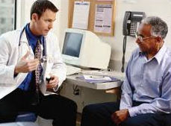
Survey Results
Primary care is one of the most convenient points of contact for substance issues
Patients are more likely to have conversations with their primary care provider than a relative, therapist, or rehab specialist
Notes:
The survey also supported the fact that SBIRT in primary care can decrease how often an individual uses alcohol and drugs, as well as the severity of that use.

Slide 30
Costs to Society
Loss of life →
More die from alcohol and drug overdoses per year than are killed in automobile accidents
More than 64,000 died from drug overdoses in 2016, including illicit drugs and prescription opioids
Approximately 88,000 die annually from alcohol-related causes
Notes:
We also know that there are many costs associated with “substance misuse” and “substance use disorders,” including loss of life – which is on the rise.
_______________________
Reference: Overdose Death Rates (https://www.drugabuse.gov/related-topics/trends-statistics/overdose-death-rates)
Reference: Alcohol Facts and Statistics (https://www.niaaa.nih.gov/alcohol-health/overview-alcohol-consumption/alcohol-facts-and-statistics)

Slide 31
Costs to Society
Yearly economic impact → $442 billion
$249 billion for alcohol misuse and alcohol use disorders
$193 billion for illicit drug use and drug use disorders
By comparison: Diabetes costs $245 billion
Notes:
Substance use also costs a lot financially, and a great deal more than other chronic diseases. By way of comparison, the annual cost to society of “substance misuse” and “substance use disorders” is $442 billion, nearly twice what it costs to manage diabetes! SBIRT aims to identify individuals early and decrease that economic burden.
_______________________
Source: Slide deck from January 30, 2017 presentation to SAMHSA Grantee by V. Murthy & K. Enomoto.

Slide 32
Summary
SBIRT is a brief and highly adaptive evidence-based practice with demonstrated results
SBIRT has been successfully implemented in diverse sites across the life span
SBIRT makes good clinical and financial sense
Notes:
In summary, there are lots of good reasons to learn how to use SBIRT and then apply it in clinical practice!

Slide 33
What’s Next
In the next session, you will learn about screening patients for substance use in a clinical setting.
Notes:
In the next session, you will learn about screening patients for substance use and administering the screening tools.

Slide 34
Acknowledgements
Content in this educational module was provided by the Substance Abuse and Mental Health Services Administration (SAMHSA) under grant to the University of Iowa with permission to adapt and use in training.
Grant #1H79TI025939-01
Notes:
Thank you to our funding agency for supporting this program.

Slide 35
Acknowledgements

