Slide 1
Motivational Interviewing: Enhancing Motivation to Change Strategies
Notes:
Welcome to “Motivational Interviewing – Enhancing Motivation to Change Strategies.” This is the third module that you’ll be taking about motivational interviewing.

Slide 2
Learning Objectives
At the end of the session, you will be able to:
Describe the stages of change.
Demonstrate at least two methods to elicit
change talk.
Use a decisional balance and readiness ruler.
Describe an overarching motivational interviewing (MI) strategy effective in Brief Intervention.
Notes:
The goals for this session are listed on the slide. As you can see, we are going to look more closely at the change process, readiness to change, and the Brief Intervention that is based on motivational interviewing.

Slide 3
Stages of Change
Notes:
Let’s begin by looking at the stages of change.

Slide 4
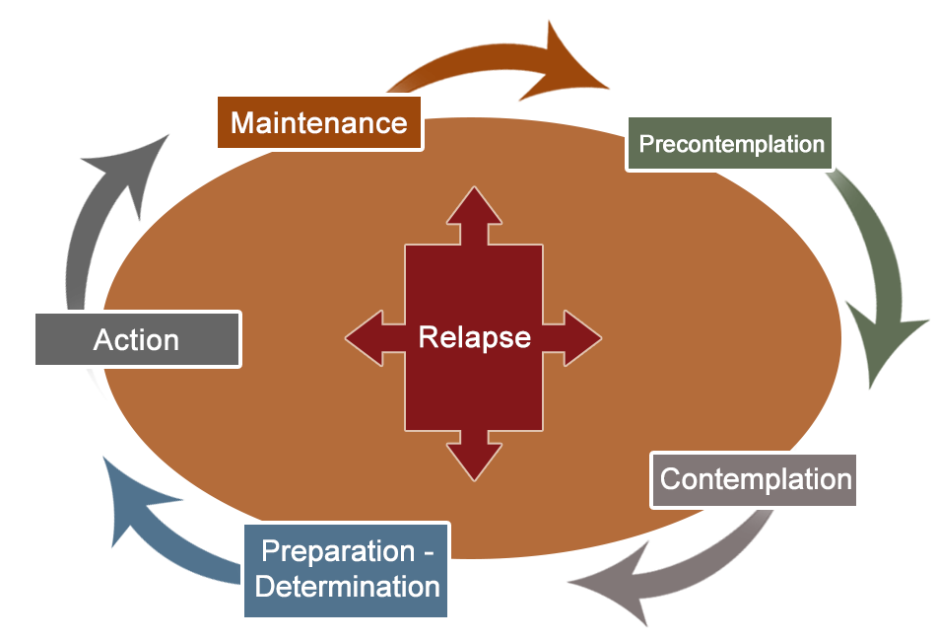
Theoretical Framework Informing MI
Prochaska and DiClemente identified five stages of change:
Precontemplation
Contemplation
Preparation
Action
Maintenance
Notes:
As you use motivational interviewing with clients, you will likely find that they are in various states of “readiness” to change: Precontemplation, Contemplation, Preparation, Action, and Maintenance.
_________________________________
Reference: Prochaska & DiClemente (1984).

Slide 5

MI Informed by Stages of Change
Precontemplation
The client is not yet recognizing a problem or considering change.
Clinician’s goal is to build rapport and raise awareness.
Clinician’s task is to inform and encourage.
Notes:
In the precontemplation stage, the client doesn’t feel there is a problem and therefore doesn’t think they need to change. In turn, the goal is to build a trusting relationship and raise awareness. Our tasks are to engage, inform, encourage, explore, and acknowledge lack of readiness.

Slide 6

MI Informed by Stages of Change
Contemplation
The client is evaluating reasons for and against change.
Clinician’s goal is to build motivation.
Clinician’s task is to explore and resolve ambivalence.
Notes:
In the contemplation stage, the client sees the possibility of change but is ambivalent and uncertain about beginning the process, so the goal is to build motivation and confidence. Our tasks are to explore and resolve ambivalence, and evaluate pros and cons.

Slide 7
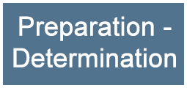
MI Informed by Stages of Change
Preparation
The client is planning for change.
Clinician’s goal is to negotiate a plan.
Clinician’s task is to facilitate decision-making.
Notes:
In the preparation stage, the client begins making a plan to change and sets gradual goals, so the goal is to negotiate a plan. Our task is to facilitate decision-making.

Slide 8

MI Informed by Stages of Change
Action
The client is making the identified change(s).
Clinician’s goal is to support implementation of the plan.
Clinician’s task is to support self-efficacy.
Notes:
The action stage occurs when the client begins to implement specific action steps and behavioral changes. Our goal at this point is to support the plan and action steps, and help think through possible needs for support. Our main task is to support the client’s confidence and self-efficacy.

Slide 9

MI Informed by Stages of Change
Maintenance
The client is not yet recognizing a problem or considering change.
Clinician’s goal is to build rapport and raise awareness.
Clinician’s task is to inform and encourage.
Notes:
In the maintenance stage, the client continues to sustain desirable actions or repeats periodic recommended steps. In turn, our goal is to help the client maintain the change or the new status quo. Here, we are mostly thinking about early changes that may signal relapse to unhealthy behaviors, or return of symptoms. Having a “prevention plan” often helps people think about “slippage.” For example, gaining more than 3 pounds may be a target in weight management; in depression treatment, failure to attend certain usual activities may signal increasing anhedonia. It all depends on the person and the problem.

Slide 10
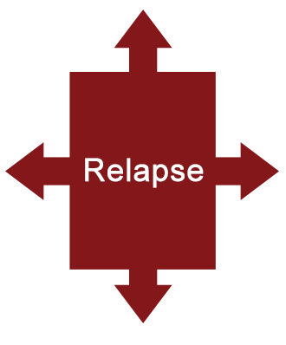
MI Informed by Stages of Change
Relapse
Event(s) trigger the individual to return to previous behaviors.
Reengage.
Review goals and strategies.
Recurrence does not equal failure.
Notes:
Events – internal or external – can trigger an individual’s return to previous behaviors and the need to cycle through the process again. Clients may have had unrealistic goals, used ineffective strategies, or put themselves in environments not conducive to successful change.
The inability to sustain changes feels demoralizing to the person and creates the feeling that it’s too hard, or not really worth the effort. However, expressions of frustration or indifference don’t necessarily mean a client has abandoned their commitment to change. Helping the person examine how the “slippage” occurred – what got in the way – can help move the person back into action.

Slide 11
Exercise
At what stage does a client consider the possibility of change?
Precontemplation
Contemplation
Preparation
Action
Notes:
Let’s take a minute now and think about the question on the slide. At what stage does a client consider the possibility of change?

Slide 12
Exercise
At what stage does a client consider the possibility of change?
Precontemplation
Contemplation
Preparation
Action
Notes:
The answer is “b – Contemplation.”

Slide 13

Remember
“Readiness to change”
State
Trait
Notes:
It is crucial to remember that a client’s “readiness to change” is a state of mind, not a trait. Readiness to change is “fluid” – meaning it will change based on the person’s experiences.

Slide 14
Change Talk
Notes:
Now let’s review the concept of change talk.

Slide 15
Increasing Change Talk
Change talk is at the heart of MI. Through our conversations, we elicit:
Desire – I wish/want to…
Ability – I can/could…
Reasons – It’s important because…
Need – I have to…
Notes:
Change talk is at the heart of MI. As the amount of clients’ change talk increases, so does their commitment to change. Through our conversations, we can evoke and affirm desire, ability, reasons, and need. To remember those, use the acronym DARN.

Slide 16

What is Change Talk?
Change talk
Client expresses motivation to change
Example
“I wish I could quit smoking because it’s a really bad example for my kids and the cost is killing me!”
Notes:
Change talk occurs when the client expresses some level of motivation to change.

Slide 17
Change Talk
As change talk emerges, affirm and
reinforce it.
Reflect and summarize consequences of the behavior identified by the client
Example: “You’re quite concerned about the effects your smoking may be having on your family. Being a good parent is important to you.”
Notes:
The A from OARS – Affirmation – is critical. Gently reflect and summarize consequences of the behavior, focusing on those that have been identified by the client.

Slide 18
Exercise
Identify the change talk statement(s):
I have to cut down on my drinking so I can make it to work on time.
My spouse wants me to lose weight.
The doctor thinks it is important for me to lower my cholesterol.
I want to stop taking my pain meds, but the pain won’t go away.
Notes:
Take a minute to consider the statements on the slide. Which ones reflect change talk?

Slide 19
Exercise
Identify the change talk statement(s):
I have to cut down on my drinking so I can make it to work on time.
My spouse wants me to lose weight.
The doctor thinks it is important for me to lower my cholesterol.
I want to stop taking my pain meds, but the pain won’t go away.
Notes:
From this list of statements, “a” is the only example of a change talk statement. Remember, the motivation to change is person-centered, not what others think or are saying.
Think about the type of change talk that is represented by statement “a.” Using the acronym “DARN,” this is an example of “R, Reasons.”

Slide 20
MI Strategies
Notes:
There are a variety of motivational interviewing strategies that are useful. Let’s take a look at three that are particularly effective when using the Brief Intervention, a semi-structured interview format related to behavior change. Additional training about the Brief Intervention will be provided later.

Slide 21



Strategies in Brief Intervention
Decisional balance
Readiness ruler
Personalized reflective discussion
Notes:
The MI strategies that are most commonly used in the Brief Intervention are listed on the slide. Let’s take a look at the decisional balance first.

Slide 22




Decisional Balance
Highlights the individual’s ambivalence (maintaining versus changing a behavior)
Leverages the costs versus the benefits
Notes:
The decisional balance is a model that helps explain behavior change. The point is to help the person look at factors that may support staying the same versus changing a behavior. In some ways, it’s a cost versus benefits assessment based on the person’s concerns that aims to leverage benefits of change against the status quo.

Slide 23

Decisional Balance
Accept all answers
Explore answers
Note both the benefits and costs of current behavior and change
Explore costs/benefits with client’s goals and values
Answers
Notes:
When conducting a decisional balance discussion, accept all answers given by the client. Avoid the urge to disagree or argue with their views; instead, explore them. Be sure to note both the benefits and costs of current behavior and of change. This exploration should include your client’s goals and values. What is important to them?

Slide 24

Exercise: Decisional Balance
Camilla, 24
Accident
Pain
Loss of income
Buys illegal drugs
Drinks excessively
Aggressive tendencies
Notes:
Let’s think for a moment about the costs of maintaining the status quo for Camilla. As you listen, make a list.
Camilla, a 24-year-old waitress, hurt her back falling from a ladder at work 2 years ago. With a herniated disc and left leg sciatica down to her foot, she reports a pain level of 9 on a 10-point scale, loss of sleep, and loss of income. Her disability payments ended after 12 months. She was prescribed Percocet for 2 months and tried to refill prescriptions with different doctors with no success. She started buying opiates off the Internet and on the street. She tried detox 3 times last year but never fully succeeded. Every time the pain gets too great, she either drinks till she passes out or finds opiates. She drinks wine during the week and martinis on the weekends but states she is not an alcoholic. She’s never had a DUI, but she has had inappropriate relations when drinking and has slapped men in anger. She and her boyfriend of 2 years have talked about getting married, but only after she gets her act together since he wants children and is concerned about her pain and its management.

Slide 25
Exercise: Decisional Balance
Identify costs of status quo for Camilla
Notes:
What are some of the costs of maintaining the status quo for Camilla?

Slide 26
Exercise: Decisional Balance
Some costs of status quo for Camilla might be:
Continued health concerns, including pain
Health hazard from mixing opioids and alcohol
Risk of arrest for buying illegal drugs; harm related to transactions or quality of drugs
Risks related to her behavior when drinking
Potential withdrawal
Compromised relationship with her boyfriend
Notes:
Here are some of the costs of status quo. Did you think of any of these? Or perhaps some others?

Slide 27
Exercise: Decisional Balance
Identify costs of change for Camilla
Notes:
On the flip side, what might be some costs of change for Camilla?

Slide 28
Exercise: Decisional Balance
Some costs of change for Camilla might be:
Fear of increased pain
Withdrawal
Notes:
Here are a couple of ideas. Did you think of anything else?

Slide 29
Readiness Rulers: I-C-R
Confidence
Readiness rulers can address:
Importance
Confidence
Readiness
Readiness
Importance
Notes:
The second MI strategy in the Brief Intervention is the readiness ruler. Readiness rulers can measure three things: Importance, or the priority to change; Confidence in one’s own ability to change; and Readiness, which is a willingness to change.

Slide 30
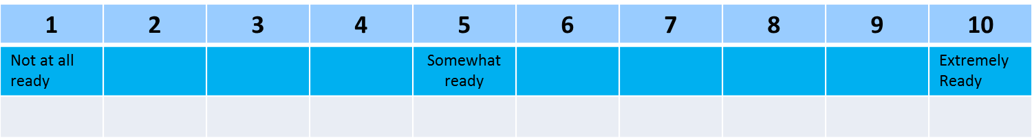
Readiness Ruler
On a scale of 1 to 10, how ready are you to make a change?
Notes:
Here’s how to use the readiness ruler. Show the client the readiness ruler and ask, “On a scale of 1 to 10, how ready are you to make a change?” If the client answers with “5,” the follow-up question would be: “That’s great. You’re 50 percent there. So, why are you a 5 and not a 3?”
Asking the client why the number is not lower invites him or her to articulate reasons and motives for considering change. If you ask why the number is not higher, it elicits barriers and reasons for staying the same. In effect, it showcases resistance talk rather than change talk.
A client may be ready to make a change but lack confidence in their ability. Until this ambivalence is addressed, they will not be effective. Remember to assess all three aspects of readiness with the readiness ruler.

Slide 31

MI is Key to Change
MI strategies facilitate...
Finding personal and compelling reasons to change
Building readiness to change
Making commitment to change
Notes:
In summary, motivational interviewing principles, steps, and strategies are the foundation of Brief Interventions to help clients make changes toward healthier lifestyles.
Now let’s talk about personalized reflective discussions.

Slide 32

Personalized Reflective Discussion
Use screening/assessment results to generate a specific type of reflective discussion aimed at gently increasing readiness and the desire to change.
Sampl & Kadden, 2001
Notes:
The third MI strategy that is critical to the Brief Intervention is personalized reflective discussion. In this context, we use selected health information to talk with our client about the identified concern. For example, assessment information related to increasing weight coupled with increased pain levels, activity intolerance, and depressive symptoms might guide a discussion of weight loss using the Brief Intervention. The point is to use MI strategies to facilitate a personalized, reflective discussion that increases the person’s readiness and commitment to change.

Slide 33
Personalized Reflective Discussion
Enhancing motivation and commitment
Initiate reflective discussion
Negotiate commitment
Enhance motivation
Provide feedback
based on screening/
assessment data
Evoke personal meaning
Notes:
There are 5 steps in the personalized reflective discussion, beginning with initiating a reflective discussion.

Slide 34
Initiating Reflective Discussion
Start the reflective discussion asking permission of our clients to have the conversation
Example: “Would it be all right with you to spend a few minutes discussing the results of the wellness survey you just completed?”
Notes:
Reflective discussion between a clinician and client usually follows other conversation. As noted earlier, relationship and rapport with the person is critical. The first step is for the clinician to ask for the person’s permission to have the conversation. Asking permission shows respect for the person’s autonomy.

Slide 35
Providing Feedback
Substance use risk
Based on your AUDIT screening—
Score: 27
You are here
Low Moderate High Very High
0 40
Review
Score
Level of risk
Risk behaviors
Normative behavior
Notes:
After being invited to discuss findings, the clinician can review the results of related health assessment data. The example shown on this slide is for the Alcohol Use Disorders Identification Test, or AUDIT, a screening tool for alcohol use.

Slide 36
Evoking Personal Meaning
Reflective questions: From your perspective…
What relationship might there be between your drinking and ____?
What are your concerns regarding use?
What are the important reasons for you to choose to stop or decrease your use?
What are the benefits you can see from stopping or cutting down?
Notes:
To evoke personal meaning from your client, use open-ended and evocative questions. This will give you a better understanding of how the client views his or her health and behavior. These questions are examples of those you might ask after reviewing the AUDIT results with your client.

Slide 37
Summarizing
Acknowledges perceived benefits of their behavior
Elicits the “personal and important” problems or concerns caused by their behavior
Elicits, affirms, and reinforces motivation to change
Helps resolve ambivalence and reinforces motivation
Notes:
As in “OARS,” summarizing the discussion provides a good way to reinforce the concerns shared and pave the way for change.

Slide 38
Enhancing Motivation
Readiness Ruler
Notes:
Using the readiness ruler after the personalized reflective discussion and summary may further enhance a client’s motivation to change. Remember, as a clinician you will decide how to best address the issues with each individual client. The information here is just a guide.

Slide 39

Negotiating Commitment
Simple
Realistic
Specific
Attainable
Follow-up timeline
Negotiating
a
PLAN
Notes:
A plan does not need to be overly complicated, but should be both realistic and specific, and one that the client is willing and able to follow. Making a plan is really just the first step; following up to check on the person’s progress is essential. In many situations, a review at 4 weeks (or sooner, depending on the problem and related risks) is essential to seeing how the plan is working for the client.

Slide 40

Summary: Benefits of Using MI
E vidence-based
P atient-centered
P rovides structure
R eadily adaptable
Notes:
In summary, the benefits of using MI are that it’s evidence-based, client-centered, provides structure to the consultation, and is readily adaptable to a variety of healthcare settings.

Slide 41







Motivation for Change
Motivation is an
intrinsic process
Ambivalence is normal
Motivation arises out of resolving discrepancy
“Change talk” facilitates change
Notes:
When it comes to motivation for change, you must always remember:
Motivation is intrinsic; it comes from within your client;
Ambivalence is normal; alternative behaviors have pluses and minuses;
Motivation emerges out of ambivalence about values and goals that conflict with behavior; and
Change talk is the essential first step to doing something different; ambivalence leads to discrepancy, which leads to change.

Slide 42
Brief Intervention
Build rapport
Evaluate pros and cons
Provide information and feedback
Build readiness to change
Negotiate an action plan
Notes:
As mentioned throughout this module, a main focus of MI training is to help clinicians gain needed knowledge and skills to use the Brief Intervention, an evidence-based, semi-structured interview process based on motivational interviewing.
The Brief Intervention consists of five main steps, as outlined on the slide.

Slide 43
Notes:
This document is available for your use as you conduct brief interventions with your clients. For now, the goal is to understand that the MI training provided here is designed to help you have short, focused discussions – ones that last from 5 to 15 minutes – and are feasible in the context of your busy clinical practice.
The common reaction of “I don’t have time for this” just doesn’t work. Important behavioral health problems can be addressed effectively and within the “allowable” billable timeframe.

Slide 44
Motivational Interviewing: Sample Exchanges
Notes:
Let’s wrap up the training with some examples of exchanges that might occur in the context of using motivational interviewing in clinical practice.

Slide 45
Notes:
These examples pertain to medication adherence. Let’s take some time to think about how you, as a clinician, might apply MI principles in practice. At the onset, the person is really resistant, but instead of challenging the person, the clinician “rolls with resistance” and affirms the positive.

Slide 46
Notes:
In response, the person talks about her daily routine and ambivalence about her blood pressure and daily challenges. The reflection communicates acceptance.

Slide 47
Notes:
Here the person’s ambivalence becomes even clearer, and risks are reflected back to help nudge the person to think more about change.

Slide 48
Notes:
Note that the clinician doesn’t offer a solution, although it might be really tempting here. Instead, an open-ended question is used to get the person to think about possible options.

Slide 49
Notes:
When the person comes up with an idea, the clinician again uses affirmation, and then asks another open-ended question.

Slide 50
Notes:
And when the person agrees to then try, the clinician summarizes and again supports the person’s efforts. This kind of interchange is pretty common, and it’s easy to both warn and give advice. However, the solutions the individual finds on their own – with your help and support – are the best.

Slide 51
This concludes the sessions on Motivational Interviewing.
Notes:
This concludes the sessions on motivational interviewing. Thank you for your attention.

Slide 52
Acknowledgements
Content in this educational module was provided by the Substance Abuse and Mental Health Services Administration (SAMHSA) under grant to the University of Iowa with permission to adapt and use in training.
Grant #1H79TI025939-01
Notes:
Thank you to our funding agency for supporting this program.

Slide 53



Acknowledgements

