Slide 1
Screening, Brief Intervention, and Referral to Treatment (SBIRT): Identifying Youth at Risk
The University of Iowa College of Nursing
With funding from the Substance Abuse and Mental Health Services Administration (SAMHSA)
Notes:
Welcome to our part of the SBIRT program focused on youth.

Slide 2
Why is Identifying Youth at Risk Important?
Alcohol is the drug of choice for youth
1 in 3 children starts drinking by the end of 8th grade; half of them report having been drunk
Between the ages of 12 and 18, the proportion of youths who drank rises from 7 percent to 70 percent
Notes:
It’s important to identify youth at risk because substance use can start early. In 2003, the average age of one’s first use of alcohol was about 14 years. If a teen drinks alcohol before the age of 15, they are 4 times more likely to report alcohol dependence later on. In addition, studies have shown that substance use increases as adolescents get older.
_______________________________________
Reference: NIAAA Surveillance Report No. 74: Trends in Underage Drinking in the United States, 1991–2003. https://pubs.niaaa.nih.gov/publications/surveillance74/Underage03.htm

Slide 3
Why is Identifying Youth at Risk Important?
Dangerous binge drinking is common and also increases with age
Binge drinking is having 5 or more drinks in a row
About 1 in 14 eighth graders, 1 in 6 tenth graders, and 1 in 4 twelfth graders report binge drinking in the past 2 weeks
Notes:
One of the issues common to youth is binge drinking, which is quite dangerous. As with substance use in general, binge drinking increases with age.

Slide 4
Why is Identifying Youth at Risk Important?
In the short term, adolescent drinking often results in:
Unintentional injuries and death
Suicidality
Aggression and victimization
Infections and pregnancy from unplanned, unprotected sex
Academic and social problems
Notes:
There are numerous short-term effects that can occur when adolescents drink, and a few are presented here. While they are noted as “short term,” they can have long-lasting impacts on the individual and those around them.

Slide 5
Why is Identifying Youth at Risk Important?
In the long term, it’s associated with:
Increased risk for dependence on alcohol later in life
Long-lasting functional and structural changes in the brain due to heavy drinking
When adolescents screen positive for one risky behavior, it’s generally a good marker for other risky behaviors
Notes:
There are also long-term effects, those we can’t see until later on in an individual’s life. Early substance use can have multiple negative impacts as a person ages.

Slide 6
Unique to Adolescents
The clinician should consider the following trends when working with adolescents:
Teen suicide rate increased 24% from 1999-2014:
In adolescents, depression has increased from 8.7% in 2005 to 11.3% in 2014
More teens are opening up about gender, sexual attraction, and LGBTQ questioning
In 2016, 3.6% of adolescents aged 12-17 reported misusing opioids over the past year
Notes:
When working with adolescents, two important trends that the clinician should consider are the teen suicide rate and the prevalence of major depressive episodes. Both have increased in the past several years.
An adolescent issue to be aware of is that more teens are opening up – and questioning – their gender and sexuality. Another issue is the increase in misuse of opioids by adolescents.
__________________________________________
Reference: National Trends in the Prevalence and Treatment of Depression in Adolescents and Young Adults. http://pediatrics.aappublications.org/content/early/2016/11/10/peds.2016-1878
Reference: Gender and Sexuality in Pediatrics. https://www.healio.com/pediatrics/journals/pedann/2016-5-45-5/%7B959b6ada-2f4a-4e70-9a75-5e52a5775639%7D/gender-and-sexuality-in-pediatrics.pdf
Reference: Key Substance Use and Mental Health Indicators in the United States: Results from the 2016 National Survey on Drug Use and Health. Retrieved from https://www.samhsa.gov/data/sites/default/files/NSDUH-FFR1-2016/NSDUH-FFR1-2016.pdf

Slide 7
Prevalence of Substance Use
Alcohol and drug use is prevalent
Of those aged 12 to 17 years, 1 out of 10 report using illicit drugs in past 30 days
Past month alcohol use:
14% among 8th graders
21% among 10th graders
49% among 12th graders
1.8 million (7.2%) were believed to need substance use disorder treatment, but only 150,000 received it
Notes:
As noted before, risks of substance use increase with age, so having discussions at earlier ages may help reduce problems later on.
It’s also important to know that while many youth need treatment, only a small fraction actually receive it.

Slide 8
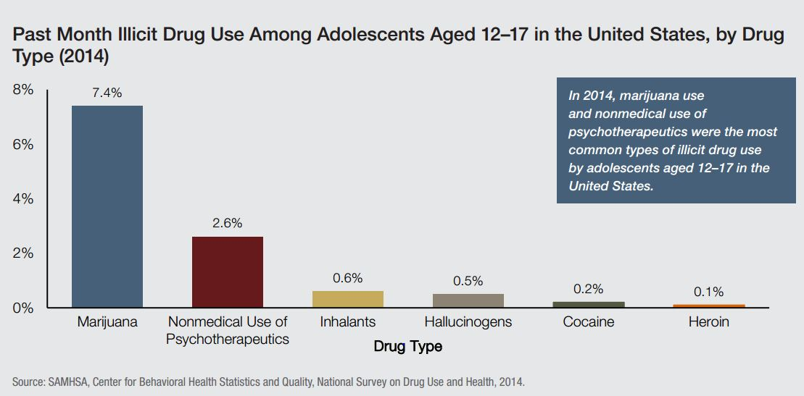
Past Month: Illicit Drug Use
Notes:
These are the 2014 study results on the different types of drugs used among adolescents between the ages of 12 and 17. Marijuana is the most commonly used drug, followed by the nonmedical use of psychotherapeutics.

Slide 9
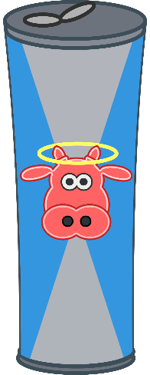
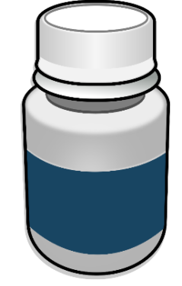
Other Substances
Performance-enhancing drugs
Used to improve any form of activity performance in humans
Examples: anabolic steroids, androstenedione, human growth hormone, erythropoietin, diuretics, creatine
Stimulants
Medication prescribed to treat health conditions
Health conditions: ADHD, narcolepsy, depression
Energy drinks
Include high levels of caffeine
Examples: Red Bull, Monster Energy, 5-hour Energy
Notes:
In addition to alcohol and drugs, other substances that youths are drawn to include performance-enhancing drugs, stimulants, and energy drinks.

Slide 10
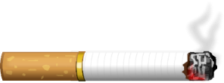
Other Substances
Nicotine products
Cigarettes, cigars, and pipe tobacco
Chewing tobacco
E-cigarettes (vaping)
Inhalants
Volatile solvents (e.g., paint thinner, nail polish remover)
Aerosols (e.g., spray paint, vegetable oil spray)
Gases (e.g., butane lighters, propane tanks)
Nitrites (e.g., room odorizer, leather cleaner)
Just because they’re legal doesn’t mean they’re safe!
Notes:
Nicotine products and inhalants are two other categories of substances that youths find attractive. Some of these substances are easy to obtain, making them easy to abuse.

Slide 11
Hazards
Increased risks for:
Overdose death
Motor vehicle crashes
Teen pregnancy
Infectious diseases like HIV, HepC
School failure
Family and relationship problems
Violence and criminal behavior
Increased risk for substance use disorder as an adult!
Notes:
The risks associated with the use of these substances are varied and can be detrimental to an adolescent’s life. One major risk is that substance use during the adolescent years can lead to an increased risk for substance use as an adult!

Slide 12
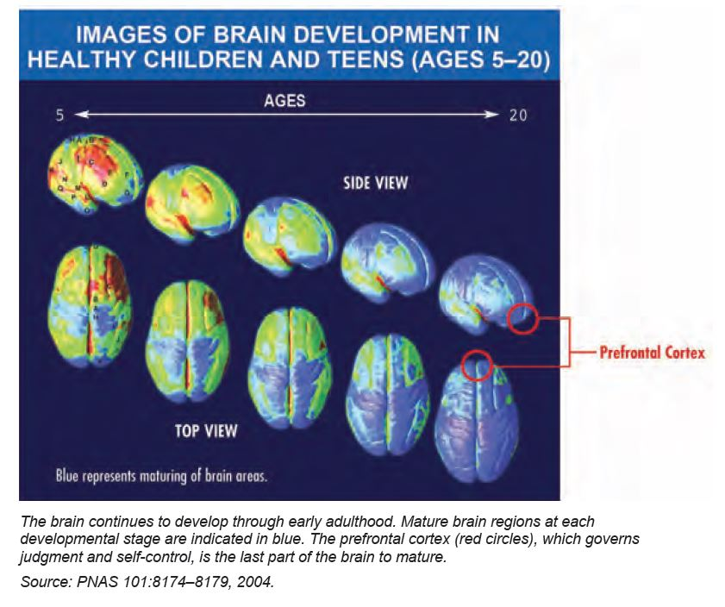
Notes:
Misuse of substances during youth impacts critical stages of brain development. Between the ages of 5 and 20, the brain is particularly vulnerable to substance use disorder. The prefrontal cortex is developing and is making connections to other brain regions that help the individual assess situations, make sound judgments, and control emotions and impulses.
The adolescent brain is likened to a car with a fully functioning gas pedal (which is the reward system), but weak brakes (the prefrontal cortex).

Slide 13
Settings
Strong evidence for SBIRT use in:
School settings
Emergency departments
Primary Care settings
“Well-Care” PCP visit
Routine health services
The American Academy of Pediatrics and the American Medical Association recommend that ALL health care providers routinely ask adolescents about drinking and drugs.
Notes:
There are various settings where teens can be asked about their drinking and drug use, including schools, emergency departments, and in the office of their primary care provider. This provides multiple opportunities for screening and early intervention.

Slide 14
Adolescent History-Taking
History needs to include:
Chief complaint or concern of both parent and teen
Past medical history: hospitalizations, injuries, pregnancies, life births
Past surgical history, including any gynecological procedures
Medications: vitamins, birth control pills, laxatives, over-the-counter drugs, supplements/vitamins
Allergies: drugs, food, environmental
Notes:
In order to effectively evaluate an adolescent for substance use, you must obtain a complete history. The history should include the chief complaint or concern of both the parent and the teen, the teen’s past medical and surgical history, all medications the teen is taking, and any allergies.
_______________________________________
Reference: Adolescent Interview. Course Presentation by Susan Van Cleve and Brenda Cassidy. September 2017

Slide 15
Overview: SBIRT in Practice Settings
Annual 3-Question Prescreen (CRAFFT Part A)
Annual prescreen (<1 min) followed by the full screen (3-5 min) doesn’t take much time!
Negative:
CRAFFT Part B Question 1 Only
Positive:
CRAFFT Part B 6 Questions
☑ Education Sheet
Low Risk:
☑ Positive Reinforcement
Risky:
☑ Brief Intervention
Harmful or Dependent:
☑ Brief Intervention
☑ Referral
The Brief Intervention and Referral require more skills, and training is often needed; SBIRT-TIPS will provide!
Notes:
The prescreening and full screening of substance use for adolescents doesn’t take much time at all – generally, no more than 5 minutes. If brief intervention or referral to treatment is necessary, you will need to rely on additional skills that you’ll learn through the SBIRT-TIPS program.

Slide 16
At Risk for Substance Use
Lots to think about…
Exposure to stress: emotional, physical abuse
Personality traits: impulsivity, aggression
Drug use at earlier age
15.2% who start drinking by age 14 develop alcohol abuse or dependence in their lifetime
25% of those who abuse prescription drugs by age 13 develop SUD in their lifetime
Anxiety, depression, other mental disorders are likely to precede substance use and contribute to it
Notes:
Another aspect to think about is why youths are at risk for substance use. Since each individual is unique and has different experiences, the reasons that they use substances can be quite varied.

Slide 17
At Risk for Substance Use
Lots to think about…
Is the teen depressed? (Can screen using the PHQ-9 or PHQ-A)
Has there been trauma in the teen’s life? (E.g., past abuse, neglect, violence)
What is the teen’s relationship with the family?
Is the teen a victim of bullying?
Has the teen attempted suicide or is the teen actively suicidal?
Notes:
Other factors that need to be considered include whether or not the teen is depressed, if there’s been any trauma in their life, and what the teen’s relationship is with their family. In addition, is the teen a victim of bullying? Have they attempted suicide or are they actively suicidal? It’s critical to think about all of these issues.

Slide 18
Confidentiality
Awareness of local, county, state, and federal regulations
Know when to break confidentiality
Imminent danger to the patient
Imminent danger to others
Situations that can affect confidentiality
Provider’s relationship with the youth
Provider’s relationship with the parent(s)
Provider’s awareness of the home situation
Guardianship status/special considerations
Notes:
When talking with adolescents, confidentiality can be a sensitive area. Make sure you’re aware of the regulations that apply to your practice location; confidentiality laws vary from state to state. Also, understand that you may need to break confidentiality if the situation calls for it.

Slide 19
Prescreen – CRAFFT Part A
“CRAFFT” is the mnemonic acronym of first letters of key words in the six screening questions.
Instruct the youth to answer these next questions honestly (and remind them of confidentiality policies).
During the last 12 months, did you:
Drink any alcohol (more than a few sips)?
Smoke any marijuana or hashish?
Use anything else to get high?
Notes:
One of the most useful tools to screen adolescents for substance use is the CRAFFT. “CRAFFT” is the mnemonic acronym of first letters of key words in the six screening questions, specifically “car,” “relax,” “alone,” “forget,” “family,” and “trouble.”
Prior to those six questions, you will ask the youth three prescreening questions. When asking about “anything else” in question 3, this includes illegal drugs, over-the-counter and prescription drugs, and things that they “sniff” or “huff.”
If the youth answers “no” to all three questions, ask only the “Car” question. This is question 1 in Part B of the CRAFFT.

Slide 20
Screening – CRAFFT Part B
CRAFFT Part B: Six “Yes/No” questions screen for at-risk drug use or alcohol problems
Have you ever ridden in a Car driven by someone (including yourself) who was high or had been using alcohol or drugs?
Do you ever use alcohol or drugs to Relax, feel better about yourself or fit it?
Do you ever use alcohol or drugs while you are Alone?
Notes:
Part B of the CRAFFT has the screening questions. Here are the first three.

Slide 21
Screening – CRAFFT Part B
CRAFFT Part B continued…
Do you ever Forget things you did while using alcohol or drugs?
Do your Family or Friends ever tell you that you should cut down on drinking or drug use?
Have you ever gotten into Trouble while you were using alcohol or drugs?
Notes:
These are the last three questions of the CRAFFT. Each “yes” response in Part B scores 1 point. A total score of 2 or higher is a positive screen, which indicates a need for brief intervention.

Slide 22
Teen Well Check Questionnaire
Kaiser Permanente: embedded in electronic health record (EHR)
Five yes/no questions about alcohol and drugs:
Do your close friends drink alcohol or get high?
Has anyone in your immediate family (parents, grandparents, or siblings) had a problem with drugs or alcohol?
During the past year, did you drink alcohol?
During the past year, did you use marijuana?
During the past year, did you use any other substance to get high, calm down, or stay awake?
Positive screen = endorsement of past year use
Notes:
This is an example of a screening tool similar to the CRAFFT that Kaiser Permanente includes in their electronic health record.
Remember: there are different ways to screen youth for substance use. The point is to routinely ask.

Slide 23
Brief Intervention
Brief Intervention principles remain the same
Based on Motivational Interviewing
Brief, focused discussions
Recognize “costs/benefits”; resolve ambivalence
Employ “change talk”
Length varies by setting
Typical 15-minute intervention in primary care
Multiple 45- to 60-minute sessions in schools
Several minutes in emergency departments
Notes:
If the results of the screening indicate that a brief intervention is needed, you’ll find that the principles used for adolescents are the same as those used for adults. Since adolescents may complete a screening in a variety of settings, the amount of time available to conduct a brief intervention will be different.

Slide 24
Brief Intervention
Lots to consider…
Ages 12 to 18 is small in span of years, but HUGE in developmental change
Biological/psychological transformations
Social and role transformations
Decreased parental control
Increased social problem-solving
Middle school vs. high school influences
Brief Intervention should reflect the characteristics and needs of the individual
Notes:
There are many things to consider when providing brief intervention to adolescents. In the short span of six years, they experience a multitude of changes and needs.

Slide 25
Brief Intervention
Greater emphasis on advice
“As your healthcare provider, I’m concerned about your health…”
“Alcohol and drugs are bad for your brain, which is still developing at your age...”
“Please don’t make things harder for yourself. You deserve to do well...”
Clear discussion of associated risks, now and in the future
Brain development: risks of psychosis, depression, addiction
Health hazards: liver, lungs, overdose
Accidents: sexual assault, car crashes
Notes:
In brief interventions for youths, there is greater emphasis on giving advice. Another useful measure is discussing the risks and providing a clear connection between those risks and their impact on the youth and those around them.

Slide 26
Brief Intervention
Lower Risk
Provide brief advice:
“I recommend that you stop drinking, and now is the best time.”
“Your brain is still developing, and alcohol can affect that.”
“Alcohol can also keep you from making good decisions and make you do things you’ll regret later. I would hate to see alcohol interfere with your future.”
Notice the good: Reinforce any strengths and healthy decisions
Explore and troubleshoot the potential influence of friends who drink or binge drink
Notes:
If the youth is at a lower risk for substance use disorder, you can provide brief advice, focus on the good things that they’re doing, and look at the possible influence that friends who drink or binge drink can have on them.

Slide 27
Brief Intervention
Moderate Risk
Does the patient have alcohol-related problems?
If no, provide beefed-up brief advice
If yes, conduct brief motivational interviewing to elicit a decision and commitment to change
Ask if parents know
Arrange for follow-up, ideally within a month
Notes:
If they’re at a moderate risk, you can start with the brief advice for Lower Risk patients and add your concern about the frequency of drinking. If their parents are aware of their substance use, use suggestions given for Highest Risk patients. We’ll discuss these during the next slide.

Slide 28
Brief Intervention
Highest risk
Conduct brief motivational interviewing
If no, provide beefed-up brief advice
If yes, conduct brief motivational interviewing to elicit a decision and commitment to change
Ask if parents know
Consider referral for further evaluation or treatment based on your estimate of severity
Arrange for follow-up, ideally within a month
From Alcohol Screening and Brief Intervention for Youth: A Practitioner’s Guide (www.niaaa.nih.gov/YouthGuide)
Notes:
If the youth resists talking with you, at least provide some advice.
If the parents know about the substance use, ask the youth for permission to share recommendations with them. If they don’t know, take into account the patient’s age, the degree of acute risk posed, and other circumstances. Next, consider breaking confidentiality to engage the parents in follow-through.

Slide 29
Brief Intervention
Various providers give Brief Intervention
Primary care providers
Mental health practitioners
Peer outreach workers
Health educators
Continued message: One size does NOT fit all! Need individualized approaches to fit both clinicians/ settings AND the needs of youth/adolescent clients!
Notes:
One of the most important things to remember is that the approach with the adolescent needs to be individualized. It has to fit the health care provider, the setting, and the needs of the youth.

Slide 30
Treatment
Lots to consider…
Behavioral health + substance use issues
Confidentiality/relationship with the youth
Parental relationship/consent
Perceived stigma (same as adults)
Availability of treatment resources
Availability of payment resources
Notes:
If you find that the youth requires treatment for their substance use, there are many things to consider. We’ll take a look at a few of these in the following slides.

Slide 31
Treatment Selection
Treatment selection based on 6 areas:
Level of intoxication and potential for withdrawal
Presence of other medical conditions
Presence of other emotional, behavioral, or cognitive conditions
Readiness or motivation to change
Risk of relapse or continued drug use
Recovery environment (e.g., family, peers, school, legal system)
Source: American Society of Addiction Medicine
Notes:
You should consider these six areas when determining the type of treatment you select for your patient.

Slide 32
Treatment Options
Common options parallel adult treatment
Outpatient/Intensive Outpatient:
Most common for adolescent treatment
For those with less severe disorders, fewer additional problems
Partial hospitalization/day treatment:
For those with more severe disorders, but who can still be safe at home
Residential/inpatient treatment:
For those with severe levels whose medical/mental health needs and addictive behaviors require 24-hour structured care
Notes:
The treatment options for adolescents run parallel to those offered for adults. Be aware of what’s available near your location.

Slide 33
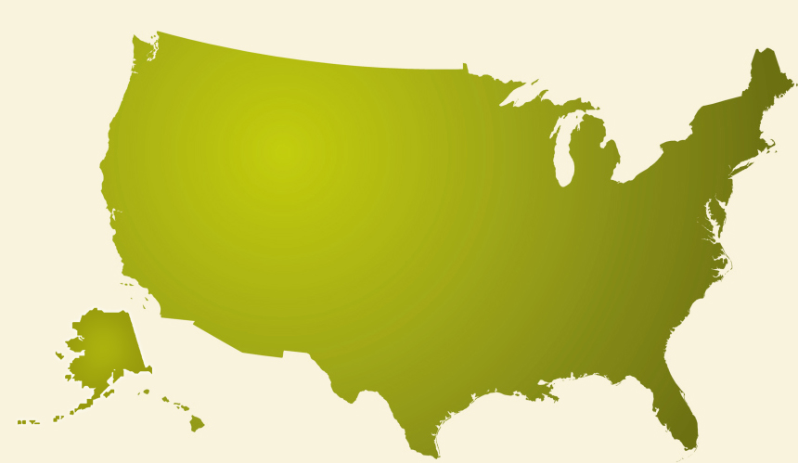
Referral Resources
SAMHSA’s National Treatment Facility Locator http://findtreatment.samhsa.gov
Enter an address or just a ZIP Code to identify services in the area.
Notes:
SAMHSA’s National Treatment Facility Locator can help you find a treatment facility. It’s very simple to use. Just enter an address or ZIP code, and a list of nearby facilities will appear.
Finally, links to detailed information about adolescent substance use are provided in a document located on the University of Iowa SBIRT website clearinghouse.
Thank you for your attention.

Slide 34
Acknowledgements

