Slide 1
Screening, Brief Intervention, and Referral to Treatment (SBIRT): Health Considerations
The University of Iowa College of Nursing
With funding from the Substance Abuse and Mental Health Services Administration (SAMHSA)
Notes:
Welcome! Today we’ll discuss some of the important relationships between physical health and substance use that clinicians may encounter as they apply the SBIRT process in practice.

Slide 2
Goals for Today
Describe health effects and interactions with substance use.
Identify symptoms suggesting the need for detoxification and referral to treatment.
Notes:
We’ll start by considering substance-related health effects that occur concurrently with substance use – both “risky” drinking that is the focus of the SBIRT process, and also substance use disorders.
We’ll also review the health effects of alcohol and think about substance intoxication that may require medical attention and specialized treatment.

Slide 3
Health Effects and Interactions
Notes:
As we briefly reviewed in our introductory SBIRT program, substance use can have an impact on many parts of our bodies. For individuals with pre-existing health problems – and particularly for those with complex medical problems that are treated with a variety of different medications – substance use can really complicate the person’s health AND treatment of their medical problems.
_______________________
Reference: Beyond Hangovers – understanding alcohol’s impact on your health

Slide 4
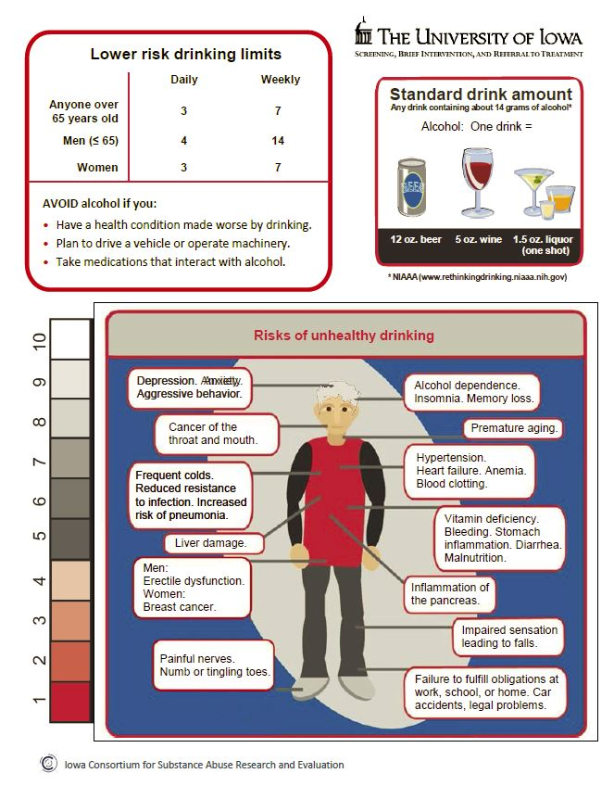
← UI Branded Education Sheet for older adults
Anyone who is given the AUDIT should also be provided a copy of the Education Sheet
Notes:
In the earlier training module, SBIRT for the Special Needs of Older Adults, we briefly reviewed some of the common health challenges older adults face, and how drinking – in particular – can complicate the course and outcome of treatment. Today we’ll take a little deeper look at some of those problems.

Slide 5
Many Great Resources!!!
Beyond Hangovers: Understanding Alcohol’s Impact on Your Health https://pubs.niaaa.nih.gov/publications/hangovers/beyondHangovers.pdf
Alcohol’s Effects on the Body https://www.niaaa.nih.gov/alcohol-health/alcohols-effects-body
Alcohol Facts and Statistics https://pubs.niaaa.nih.gov/publications/alcoholfacts&stats/AlcoholFacts&Stats.pdf
Health Consequences of Drug Misuse https://www.drugabuse.gov/related-topics/health-consequences-drug-misuse
Notes:
Most of what is known today about health risks relates to excessive alcohol use. However, there is also a growing body of evidence about both illicit drugs and misuse of opioids. As listed on the slide, there are some great educational materials available at no cost, which can help with educating peers in health care settings and clients alike. We encourage you to take time to review these to supplement the content provided in this module.

Slide 6
Health Assessment Data
Keep substance use in mind →
Presenting problems/observations
Physical assessment findings
Lab results
Collateral interviews: What are others saying? Concerned about?
Health conditions may be the “signal” to explore substance use!
Notes:
While it’s beyond the scope of this module to review common physical findings, lab values, or other data that may relate to substance use, we urge you to think carefully about health-related complications of alcohol and drug use as antecedents to discussion. The SBIRT annual screen is just one way that health care providers may detect substance use.

Slide 7
Brain
Alcohol and drugs interrupt communication pathways and change brain structure and chemistry
Disruptions in mood, behavior, cognition
Motor coordination, sleep, temperature regulation
Two special risks →
Prenatal alcohol exposure; fetal alcohol syndrome
Adolescent substance use; affects the brain while it is still in development
Notes:
Alcohol-related disruptions to neurotransmitters can trigger mood and behavioral changes, including depression, agitation, memory loss, and even seizures. With long-term and heavy use, alterations in neurons lead to brain mass and structure changes that may affect a wide range of abilities.
And as we reviewed in the program for youth, there are special risks associated with substance use early in life, from pregnancy through adolescence.
_______________________
References:
Beyond Hangovers – understanding alcohol’s impact on your health
The Affects of Long Term Drug Use On The Brain (http://www.narconon.org/blog/drug-use/the-affects-of-long-term-drug-use-on-the-brain/)
The Influence of Substance Use on Adolescent Brain Development (https://www.ncbi.nlm.nih.gov/pmc/articles/PMC2827693/)

Slide 8
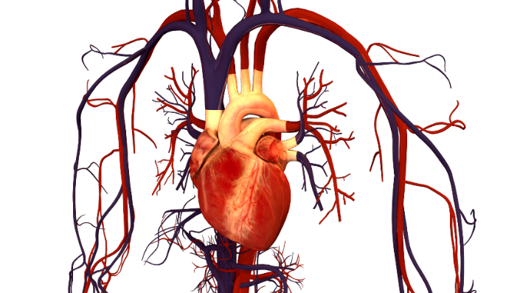
Heart/Vascular
Cardiomyopathy: Long-term heavy drinking (anatomic function)
Arrhythmias (physiologic function)
Atrial fibrillation
Ventricular tachycardia
Strokes
Hypertension
Additional risks with illicit drugs; varies by drug type
Notes:
Researchers now understand that drinking moderate amounts of alcohol can protect some individuals from the risks of coronary artery disease. However, they also know that binge or long-term drinking and drug use cause a wide variety of cardiovascular risks. Evidence also indicates that drug use has considerable implications for cardiac health – from risks of myocardial infarction to arrhythmias.
_________________________
References:
Beyond Hangovers – understanding alcohol’s impact on your health
Addiction, Heart Disease, and Stroke (https://www.recoveryconnection.com/addiction-resources/addiction-health-issues/addiction-heart-disease-stroke/)

Slide 9
Cancer
Alcohol and drug use are associated with increased risk for many types of cancer →
Mouth
Esophagus
Pharynx
Larynx
Liver
Breast
Colon
Rectal
Notes:
The more a person drinks, the higher the risk for a variety of cancers.
The National Cancer Institute identifies alcohol as a risk factor for mouth, esophagus, pharynx, larynx, liver, and breast cancers. Heavy drinking can also increase the risk of developing other types of cancer, such as colon or rectal cancer.
_________________________
References:
Beyond Hangovers – understanding alcohol’s impact on your health
Medical Consequences of Drug Abuse – Cancer (https://www.drugabuse.gov/publications/medical-consequences-drug-abuse/cancer)

Slide 10
Immune System
Chronic diseases are associated with impaired bone marrow function
Weakens the immune system
Impacts defense systems
Innate
Adaptive/acquired
Increases susceptibility to infections and disease
Pneumonia
Tuberculosis
Notes:
Drinking too much alcohol can weaken the immune system, which makes it easier for diseases to overtake the body. It can suppress both the innate and acquired immune systems, creating vulnerability to illness and disease that the person would otherwise resist.
_________________________
References:
Beyond Hangovers – understanding alcohol’s impact on your health

Slide 11
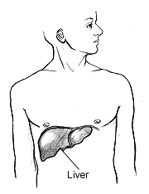
Liver
Alcohol consumption increases the risk of liver damage; the amount of alcohol doesn’t correlate well with the amount of damage to the liver
Alcoholic hepatitis – inflammation due to excessive fat in the liver
Fibrosis – scar tissue
Cirrhosis – deterioration of the liver
Heroin, inhalants, steroids, and opioids → liver damage
Notes:
Heavy drinking causes fat to build up in the liver, which can lead to dangerous inflammations and also development of scar tissue. Excessive scar tissue can lead to cirrhosis of the liver. Complications of cirrhosis may include jaundice, insulin resistance and type 2 diabetes, and liver cancer. Chronic use of some drugs – such as heroin, inhalants, steroids, and opioids – can also lead to significant liver damage.
_________________________
References:
Beyond Hangovers – understanding alcohol’s impact on your health
Liver Damage (https://www.drugabuse.gov/publications/medical-consequences-drug-abuse/liver-damage)

Slide 12
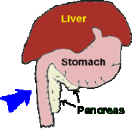
Pancreas
Substance use can lead to pancreatic organ damage
Heavy, long-term drinking
Some drugs
Increases risks for →
Pancreatitis
Acute
Chronic
Pancreatic cancer
Notes:
Long-time excessive alcohol consumption can lead to pancreatitis. Damage can also be caused by heroin, cocaine, and non-medical use of prescription drugs. Pancreatitis is a risk factor for the development of pancreatic cancer.
_________________________
References:
Beyond Hangovers – understanding alcohol’s impact on your health
The Effects of Drug Abuse on Your Pancreas (http://www.drugrehabfl.net/the-effects-of-drug-abuse-on-your-pancreas/)

Slide 13
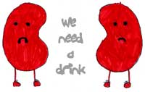
Kidney Function
Alcohol can worsen kidney disease
Binge drinking can lead to acute kidney failure
Drugs are also associated with damage or failure
Heroin
Inhalants
MDMA (ecstasy)
PCP
Of WATER, not alcohol!!!
Notes:
Certain drugs and the excessive use of alcohol can cause kidney damage or lead to kidney failure.
_________________________
References:
Alcohol and Your Kidneys (https://www.kidney.org/atoz/content/alcohol)
Medical Consequences of Drug Abuse – Kidney Damage (https://www.drugabuse.gov/publications/medical-consequences-drug-abuse/kidney-damage)

Slide 14
Smoking, Tobacco, Nicotine
Alcohol and tobacco are often used together
Roughly 70% of people with an alcohol-related substance use disorder use tobacco products
Alcohol and substance use is associated with higher rates of tobacco use
Nearly 60 percent of new smokers were under the age of 18 (in 2010)
Notes:
Another important consideration is the relationship between tobacco use and substance use. As outlined on the slide, there’s a strong relationship between smoking and both alcohol and drug use. In turn, we urge thoughtful consideration of possible substance use among clients who may smoke, particularly youth.
_________________________
References:
Smoking and Adolescence (https://www.drugabuse.gov/publications/research-reports/tobacco/smoking-adolescence)
Alcohol and Tobacco (https://pubs.niaaa.nih.gov/publications/AA71/AA71.htm)
Substance Use and Tobacco (http://www.publichealth.va.gov/smoking/substance-use-tobacco.asp)
The association between cigarette smoking and drug abuse in the United States (https://www.ncbi.nlm.nih.gov/pubmed/11110061)

Slide 15
Complex Medical Problems
Substance use makes it more difficult to treat underlying medical conditions, including:
Cardiovascular
Endocrine
Autoimmune
Effectiveness of medications can also be impacted.
…and many others!
Notes:
This is just a brief list of medical conditions that may become more complex when substance use is involved. Alcohol and drug use can make the medical condition worse, or more difficult to manage. For those who use multiple drugs to treat their health conditions, alcohol use can interact with those medications and cause problems, particularly in older adults who have multiple medical conditions. In short, this is another important sub-population to carefully monitor for substance use!
_________________________
References:
Psychotropic drug use and alcohol consumption among older adults in Germany (http://bmjopen.bmj.com/content/6/10/e012182.reviewer-comments.pdf)
Alcohol, drugs and much more in later life (http://www.scielo.br/scielo.php?script=sci_arttext&pid=S1516-44462002000500008)

Slide 16
Medical Detoxification
SBIRT focuses on identification of risky behaviors, but . . .
Clinicians also need to recognize intoxication that warrants medical attention
Recognize warning symptoms
Understand detoxification methods
Be PREPARED
Know who/what your resources are!
Notes:
You are not expected to use detoxification methods with your clients. However, it’s important to understand warning signs that a client may be using alcohol or drugs at a level where they need help to safely stop. Being prepared is really the main issue.

Slide 17
Signs and Symptoms of Withdrawal
Emotional symptoms
Anxiety
Restlessness
Irritability
Insomnia
Headaches
Poor concentration
Depression
Social isolation
Physical symptoms
Sweating
Racing heart
Palpitations
Muscle tension
Tightness in the chest
Difficulty breathing
Tremor
Nausea, vomiting, or diarrhea
Notes:
The signs and symptoms of withdrawal from alcohol and drug use cover a wide range of both emotional and physical symptoms. Of equal importance, withdrawal symptoms vary from person to person.
_________________________
References: Withdrawal (http://www.addictionsandrecovery.org/withdrawal.htm)

Slide 18
Signs and Symptoms of Withdrawal
Dangerous symptoms that require emergent medical treatment include:
Grand mal seizures
Heart attacks
Strokes
Hallucinations
Delirium tremens (DTs)
Notes:
The most dangerous physical withdrawal symptoms come from suddenly stopping the use of alcohol and tranquilizers. The risk of having withdrawal symptoms that require hospitalization increases with each sudden withdrawal.
_________________________
Reference: Withdrawal (http://www.addictionsandrecovery.org/withdrawal.htm)

Slide 19
Detoxification/Referral
Detox alone isn’t enough →
Important first step in treatment
Necessary to reduce risks of relapse
Careful/thoughtful assessment is essential to guiding next steps
Work toward building relationships to support crisis intervention decisions!
Notes:
Some individuals may present to you asking for help with detoxification from alcohol or drugs. Decisions about next steps should be guided by thorough evaluation AND also what options are readily available.
For example, you may attempt to refer the patient for specialty treatment, but the service is already full and wait-listed. Having a working relationship with specialty services ahead of time will help in the decision-making process needed to keep the person safe. As discussed in the SBIRT Core curriculum, a “warm handoff” that supports the person as they get to treatment is essential. Individuals with strong support systems are more likely to succeed.
In some cases, emergency services may be indicated, and clearly any dangerous symptoms of withdrawal will require immediate emergency care.
_________________________
Reference: Detox: Summary & Key Issues to Remember (http://iusbirt.org/course2/detox-summary-key-issues-to-remember/)

Slide 20
How Detox Works
Close supervision/continuous monitoring is necessary over the course of days to prevent delirium tremens (DTs)
“Cold turkey” is never recommended without medical supervision
Benzodiazepines are commonly used in withdrawal protocols
Good resource → Alcohol Withdrawal Treatment, Symptoms, and Timeline http://americanaddictioncenters.org/withdrawal-timelines-treatments/alcohol
Notes:
While every individual’s experience with detox will be different, there are guidelines to assist in clinical decision-making. The one provided by the American Addiction Centers is a good example, but there are others that may provide better guidance based on your clinical setting and the primary population that you serve. As before, collaborating with substance use specialty care providers in advance of a crisis can ease the tension of knowing what is best for individual clients in your practice.
_________________________
Reference: Alcohol Withdrawal Treatment, Symptoms, and Timeline (http://americanaddictioncenters.org/withdrawal-timelines-treatments/alcohol/)

Slide 21
Summary
Understanding and identifying substance-related health effects and interactions is key to comprehensive care
Identifying signs of withdrawal can avert crises; referral to treatment is the preferred intervention to manage withdrawal
Notes:
In summary, concurrent medical and substance use disorders demand thoughtful assessment and treatment. Using standardized scales and physical findings based on assessments helps clinicians better gauge therapeutic next steps. While treatment can be challenging for those with dual diagnoses or co-occurring conditions, understanding the complexity of issues is an important first step in the provisions of comprehensive, competent care and treatment.

Slide 22
Acknowledgements

