Slide 1
Screening, Brief Intervention, and Referral to Treatment (SBIRT) Core Curriculum: Getting SBIRT into Practice
The University of Iowa College of Nursing
With funding from the Substance Abuse and Mental Health Services Administration (SAMHSA)
Notes:
Welcome to our program about approaches that help to integrate SBIRT practices into clinical settings.

Slide 2
SBIRT in Clinical Settings
Annual 2-Question Prescreen
Annual 2-item screen (<1 min), followed by the full screen ONLY if indicated! Full screen (3-5 min) doesn’t take much time!
Negative:
Stop
Positive:
Full AUDIT or DAST-10
☑ Education Sheet
Low Risk:
☑ Positive Reinforcement
Risky:
☑ Brief Intervention
Harmful or Dependent:
☑ Brief Intervention
☑ Referral
Notes:
Let’s start by quickly reviewing the process that’s involved in using SBIRT in clinical practice.
This is to help remind you that the process of screening doesn’t take much time, and that both the AUDIT and DAST can be self-scored.

Slide 3
Prescreening Results
Negative
Based on previous experiences with SBIRT, 75% of prescreens are NEGATIVE
Positive
About 20% to 25% are POSITIVE, indicating you use the AUDIT, DAST, or both
Notes:
On average in primary care settings, 20 to 25 percent of individuals screen positive, and the rest are negative. So again, about a fourth of people seen in primary care will need the AUDIT or DAST.

Slide 4
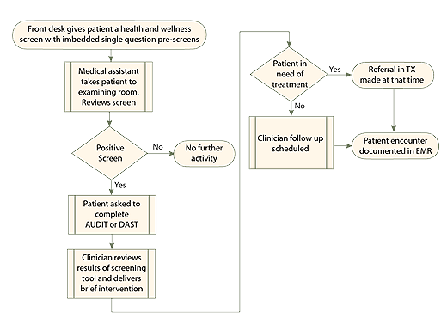
Screening in a Clinical Setting
Most settings use a team approach. Different steps can be done by different individuals and achieve the same outcomes!
Notes:
The process can be applied in many different ways. Most settings use a team approach, but there are additional options, which we’ll talk about today.

Slide 5
Using SBIRT in Practice
Like other evidence-based practices…
Great to know about evidence/success
Hard to implement in daily practices!!!
Too busy
Too much paperwork already
Not enough staff to help
Not comfortable with substance use discussions
Notes:
We’ve known for a long time that getting evidence-based practices into daily care – in any setting – is often difficult. There’s a long list of reasons as to why busy clinicians may “push back” on adding something new to their already hectic schedule!
However, as noted previously, SBIRT doesn’t need to take a lot of time. It actuality, many sites are already screening, but not in a standardized manner. This ends up being more time-consuming – trying to determine the next step – and the results are often more difficult to analyze than when using a screening tool with specific response options.

Slide 6
Using SBIRT in Practice
Additional concerns:
Too much to learn
No time to learn new skills (Motivational Interviewing, Brief Intervention)
Availability of and access to SBIRT training
Workflow issues
Sustainability
Notes:
Some individuals may think there’s too much to learn or there’s no time to learn, but keep in mind that you don’t need to learn everything at once! Introduce SBIRT in increments, and take advantage of the free online training modules – no more than 20 minutes each – that can be viewed as your schedule allows.
We’ll address some of the other concerns later in this module.

Slide 7
Models for Adoption of Evidence
Lots of models related to changing practice
The Iowa Model https://uihc.org/iowa-model-revised-evidence-based-practice-promote-excellence-health-care
Strengths-Weaknesses-Opportunities-Threats (SWOT) Analysis http://www.health.state.mn.us/divs/opi/qi/toolbox/swot.html
Rapid Cycle Quality Improvement (RCQI) http://www.health.state.mn.us/divs/opi/qi/toolbox/pdsa.html
https://www.healthit.gov/providers-professionals/faqs/how-do-i-use-rapid-cycle-improvement-strategy
Notes:
It’s beyond the scope of this training module to go over some of the common models for implementing changes in practice, including the adoption of evidence-based practices. However, you may want to review one or more of the websites shown here to learn about change models that may help guide the use of SBIRT.

Slide 8
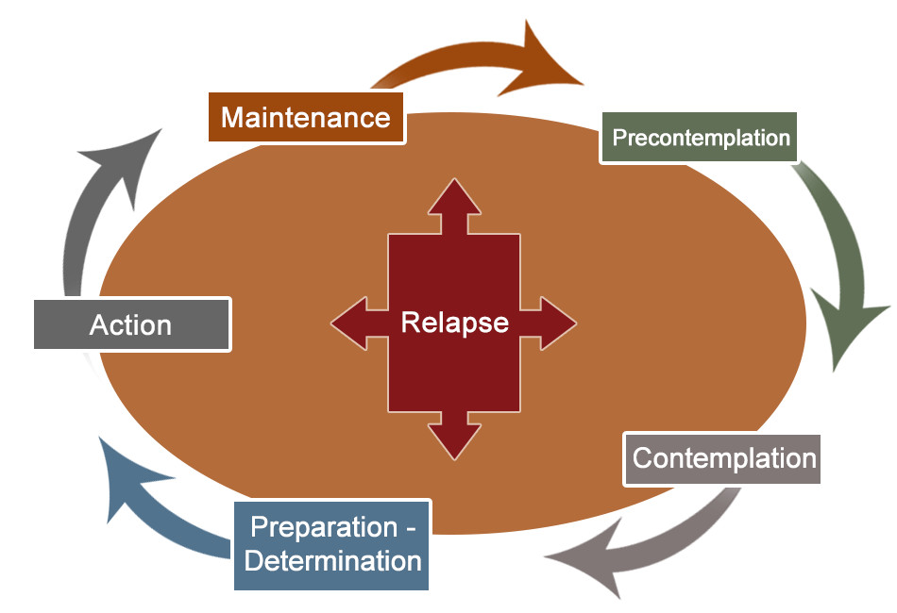
Theoretical Framework Informing MI
Prochaska and DiClemente identified five stages of change:
Precontemplation
Contemplation
Preparation
Action
Maintenance
Notes:
In fact, the very same theoretical model that we discussed when using motivational interviewing with patients can be applied to system-wide changes, such as the adoption of SBIRT.
Like people, the organization you are working in may be in various states of “readiness” to change: Precontemplation, Contemplation, Preparation, Action, and Maintenance.
_________________________________
Reference: Prochaska and DiClemente (1984).

Slide 9
SBIRT Model Matrix
Systems-Level Implementation of Screening, Brief Intervention, and Referral to Treatment
Technical Assistance Publication Series, TAP 33
SAMHSA
www.samhsa.gov
(free publications)
Notes:
The SBIRT model matrix shown on this slide is from TAP 33, which discusses strategies related to implementing SBIRT in practice settings. We highly recommend getting a copy if you’re leading a team to adopt SBIRT in your practice.
Much of what we’ll review in this module is based on this report, which incorporated the experiences of SBIRT Service grantees when they’ve implemented SBIRT in a variety of clinical sites. These sites included emergency departments, primary care clinics, and community-based service settings.
_______________________
Page 21: ATOD stands for alcohol, tobacco and drugs and ATOD+ means other behavioral risk factors are also involved, like inactivity, poor diet.

Slide 10
SBIRT Model Matrix
Three main topics that intersect →
Service delivery: What SBIRT services will be delivered? What risks will be assessed?
Implementation model: How will services be provided? Who will provide what services?
Settings: What are the unique characteristics (and challenges!) of the program setting or service area? Who is the target population?
Notes:
The matrix pictured on the previous slide gets at the “who,” “what,” and “where” questions that need to be addressed to implement SBIRT in practice.
______________________________________
Page 21

Slide 11
Planning Process & Collaborations
Assess organizational readiness
Motivation for change → Perceptions of current functioning, needs for improvement?
Institutional resources → Adequacy of office space, staffing?
Attributes of staff members → Confidence in counseling abilities, adaptability?
Organizational climate → Clarity of mission?
Medical Organizational Readiness for Change (MORC), Bohman et al., 2008
Notes:
As we said earlier, organizations can differ dramatically in their readiness and capacity to implement new practices. The four main ideas listed on this slide are actually part of an assessment tool that Bohman and colleagues used to assess organizational readiness for implementing SBIRT.

Slide 12
Planning Process & Collaborations
Involve as many staff members as possible
Who are the primary stakeholders?
Who has useful skills and experience?
Assess what is needed
Is it possible to use existing staff to provide SBIRT?
What training will they need?
Will additional staff be needed?
What are the space considerations?
Notes:
Involving as many staff stakeholders as possible in planning discussions can help identify positives but also negatives, which will need to be overcome. An important starting point is to determine what staff will be needed, and what training and support they need to be successful.

Slide 13
Planning Process & Collaborations
Set clear goals
What is realistic given resources available?
What is a logical starting point?
Assign clear roles and responsibilities
Who is the logical coordinator?
Who can help with specific tasks (billing, EHR)?
Develop collaborations and partnerships
Other departments in your health system?
Agencies or services outside your setting?
Notes:
Working to be as clear as possible about what you are doing and who can help is really important to moving the process along. Establishing partnerships and collaborations with others – both inside and outside of your organization – can help support your sustainability and success over time.
Using your target population can help guide the type of collaborators that might be most useful. For example, a youth-focused SBIRT program might involve athletic advisors or staff from student housing, student counseling services, or crisis services.

Slide 14
Identify the Setting
Questions to consider:
Who is the target audience?
Does the target audience have access to this setting?
What are the unique characteristics and challenges?
What resources are available?
What are the options/opportunities for screening?
What are the options for privacy?
Notes:
An important starting point is to determine your target audience. What population of people do you want to include in SBIRT screening?
The target group might be defined by age, health risk factors, or sociodemographic variables. Other setting-related questions pertain to characteristics and challenges that might include things like staffing, space, or access by consumers.
In short, a number of setting-specific questions will guide what is practical to do. After thinking about the setting in general, the next step is to consider which implementation model makes the best sense.

Slide 15
Implementation Models
In-House Generalist → a staff member who is trained to perform SBIRT in addition to usual duties (not a substance use professional)
Performs screening, brief intervention (BI); makes referrals to treatment
Pros: Recommendations can be tied to other health or medical problems; increases comfort for the person
Cons: Competing demands; discomfort with having substance use conversations
Notes:
The most common and effective approach is to train existing staff in the health center or clinic to use SBIRT as part of their regular practice.
The In-House Generalist model affords providers the opportunity to talk with their own patients. This often increases comfort for the person and can help the provider tie substance use to other issues.
The downside is that providers are busy and might omit SBIRT, and perhaps not all of them will be comfortable with having the needed conversations.

Slide 16
Implementation Models
Lessons learned: Overcoming barriers to In-House Generalist
Implement SBIRT in ways to reduce staff burden
Develop strong SBIRT “Champions”
Provide time for “buy in” activities
Provide adequate training and support
Collect and share information about outcomes to help staff see how they are helping people
Notes:
Over time, SBIRT Service grantees found that the approaches listed here made a big difference in the successful adoption of the In-House Generalist approach.

Slide 17
Implementation Models
In-House Specialist → a person already trained in SBIRT is hired specifically for this role
Performs all SBIRT-related activities
Pros: Frees regular staff from having to conduct SBIRT-related activities; provides consistency in service
Cons: Non-medical specialists may find health setting challenging; turf wars; supervision issues; disagreements on roles
Notes:
Another approach is to hire a specially-trained staff member to conduct all SBIRT-related work in the clinical setting.
While this may sound good to those who usually staff the clinic, it has the downside of creating situations in which differences of opinion arise between the substance use counselor and the medical providers.
These pitfalls can be overcome with clear organizational planning, but both the plan for practice and the person hired should be carefully considered.

Slide 18
Implementation Models
Contracted Specialist → an outside provider conducts SBIRT services
Performs all SBIRT-related services
Pros: Frees regular staff from having to conduct SBIRT; provides consistent quality
Cons: Time needed to learn about organizational culture, setting, staff; insurance reimbursement may be a problem
Notes:
A third approach is a variation on having an In-House Specialist. Instead of the clinic actually hiring a specialist to be part of the clinic team, this approach “co-locates” an outside provider – a Contracted Specialist – in the clinic and lets them do all the SBIRT work.

Slide 19
No One Best Way!!!
Blended models are commonly used
In-house generalist does prescreening and screening; a contracted specialist does the brief intervention and referral
Options and choices depend on:
Volume of patients seen
Accessible community resources
No matter which model, many different professionals and paraprofessionals use SBIRT!
Notes:
An important consideration is that most SBIRT Service grantees eventually found one or more “blended” approaches to using SBIRT. One of the most common is having In-House Generalists do the prescreening and screening. If a brief intervention is needed, either another In-House Generalist or a Contracted Specialist takes it from there.
There is really no one “best” way since it depends on the resources and characteristics of the setting.
One thing about SBIRT use that is consistently true is that nearly anyone who is willing and is appropriately trained can provide SBIRT! Nurses, physicians, nurse practitioners, physician assistants, social workers, psychologists, health educators, hospital residents and interns, medical assistants, school counselors, and additional professionals, can all provide SBIRT!

Slide 20
Service Components
Screening → WHO will be screened?
Will screening be universal?
Will prescreening be used?
Will a subset of the population be screened? How will those individuals be identified?
What is realistic given resources available?
Will screening be done at every visit? At regular intervals?
Notes:
The third major area to think about in getting SBIRT into practice is the actual service package you want to offer.
We encourage doing universal screening on an annual basis for all patients in primary care. However, there may be variations on what you decide to do – particularly at the beginning when you’re working to get SBIRT started. So, start with screening. What specifically are you asking the team to do? What makes the best sense?

Slide 21
Service Components
Screening → WHAT are you screening for?
Risky/harmful alcohol use?
Illegal drug use?
Prescription medication misuse/abuse?
Tobacco use?
Notes:
Our training highly recommends screening for alcohol and drugs, both illicit and prescription. However, what you decide to implement in your practice setting may depend on both the needs of the community and the comfort level of the providers.
While we highly endorse the AUDIT and DAST, there are other options available. The most important factors are to understand the benefits and uses of the tools, and then use them consistently. TAP 33, on which this module is based, reports that there are more than 25 validated self-report screening tools available!

Slide 22
Service Components
Screening → HOW will patients be screened?
What scales or instruments will be used?*
What are the key characteristics of the target population? Age? Literacy level? Cognitive functioning?
What percent cannot self-administer?
What language(s) do patients understand?
Will staff administer? Or patients self-complete?
Who will score? Interpret results?
*See TAP 33, p. 28, for examples
Notes:
Another set of questions pertains to the “how” of screening patients related to the unique needs and characteristics of the target population.
There are likely big differences in the patients who come to federally qualified health centers for treatment compared to the patients in private health centers. Factors like age, literacy, abilities, and language are all important to factor into the planning process.

Slide 23
Service Components
Brief Intervention → How will the BI be provided?
Where and when will BI occur? Onsite? By referral?
Who will provide onsite BI?
What educational materials will be used?
What community resources may be tapped?
What training do staff need?
Notes:
Although our curriculum offers training for providers to complete screenings, use the brief intervention, and make referrals to specialty treatment, in practice you and your clinic may decide on another model.
As you consider the options, it’s important to think about workflow and how patients will be provided the brief intervention. In lots of ways, this may be the most challenging part of implementing SBIRT in practice.

Slide 24
Service Components
Referral to Treatment → What processes best fit resources and needs of patients and the setting?
Who will make the referrals to treatment?
What resources are available? Know in advance!!!
What processes best support a “warm handoff”?
What follow-up methods are needed?
Notes:
Referral to treatment should follow the same basic principles that were discussed in the Core Training Curriculum. Knowing the community ahead of time and establishing partnerships with specialty substance use services in advance of needing their help is critically important.
Deciding what constitutes a “warm handoff” from you to the specialist is another really important process to consider ahead of time. Identify the type and extent of follow-up that your clinic offers as the “standard of practice” for patients who are referred. Remember, the goal is to have organizational standards that everyone follows.

Slide 25
Service Components
Referral to Treatment → Lessons learned
Make the referral from your clinic (warm handoff)
Talk through transportation issues
Consider use of supportive services
Peer/mentor health educator support
Case management
Negotiate dedicated treatment slots for SBIRT patients
Notes:
Referral procedures should both motivate patients to enter treatment and connect them with a convenient, accessible, acceptable, and affordable specialty treatment program.
Some of the strategies that have helped SBIRT Service grantees make successful referrals are listed on this slide.

Slide 26
Service Components
Evaluation plan and records → What is the best way to track SBIRT practices for individuals and the system?
What are the best ways to easily identify patient level information?
Initial screen score(s)?
Interventions used?
Progress notes?
Referrals made?
Follow-up activities/outcomes?
Notes:
Evaluation is critical to sustainability. Both process and outcome data can guide additional changes, encourage staff that they are making an important contribution to the health of the patients, and provide justification for ongoing use.
As you think about implementing SBIRT in practice, be sure to consider how key evaluation points can be easily accessed and summarized.

Slide 27
Service Components
Evaluation plan and records → How do staff think SBIRT is working for them? Patients?
What is the plan for staff evaluations?
Frequency? Type of feedback? Who is involved?
What improvements can be made?
What is working well/should be continued?
What resources are needed to maintain progress?
Notes:
Staff who are participating in SBIRT implementation and use in daily care should also be included in evaluation plans. Their input related to what works or not is critically important to adoption and sustainability. As you think about implementing SBIRT in practice, make staff evaluation and input part of the process.

Slide 28
Reimbursement
Billing codes → Support for adoption of SBIRT
Commercial Insurance
CPT 99408: Alcohol and/or substance (other than tobacco) abuse structured screening and brief intervention, 15-30 minutes
CPT 99409: Alcohol and/or substance (other than tobacco) abuse structured screening and brief intervention, >30 minutes
Notes:
An important consideration in planning SBIRT implementation in practice relates to the funding support that helps offset staff time to use the process.

Slide 29
Reimbursement
Billing codes → Support for adoption of SBIRT
Medicare
G0396: Alcohol and/or substance (other than tobacco) abuse structured screening and brief intervention, 15-30 minutes
G0397: Alcohol and/or substance (other than tobacco) abuse structured screening and brief intervention, >30 minutes
G0442: Annual alcohol misuse screening, 15 minutes
G0443: Brief face-to-face behavioral counseling for alcohol misuse, 15 minutes
Notes:
Discussing billing options that support screening and brief interventions can be an important motivational factor when thinking about adopting SBIRT in a practice setting.

Slide 30
Reimbursement
Billing codes → Support for adoption of SBIRT
Medicaid
H0049: Alcohol and/or drug screening
H0050: Alcohol and/or drug services, brief intervention, per 15 minutes (not currently “unlocked” in Iowa)
Affordable Care Act (2010) includes substance use disorders as “one of the ten elements of essential health benefits”
Notes:
An important shift in Medicaid funding occurred with the Affordable Care Act. Prior to the ACA, the state Medicaid agency had to agree to reimburse for substance use services – it was not a given. Sustained efforts on the part of SBIRT advocates were needed to “unlock” the codes supporting substance use screening and intervention.

Slide 31
Cost Effectiveness
Why SBIRT? Cost-benefit analyses suggest…
Screening and BI for risky alcohol use → $43K in future healthcare use for every $10K invested
Fewer hospital days
Fewer ED visits
Meta-analysis of 15 studies of unhealthy alcohol use → Cost-saving benefits met or exceeded standard preventive healthcare services – like immunizations and colorectal screening
Notes:
In addition to generating revenue for the healthcare setting, using SBIRT is well-established as being cost-effective. The investment in providing SBIRT in clinical practice settings saves money by reducing risks of later health problems.
Of interest, the meta-analysis of using screening and brief intervention for unhealthy drinking demonstrated that SBIRT was as cost-effective as many standard preventive services – like immunizations and colorectal screening.

Slide 32
Key Elements of Sustainability
Vision: What is the scope, scale of operation, and timeline? How does it fit in the larger community?
Results Orientation: What results will be achieved for the target population? What indicators and performance measures will be used to track progress?
Financing: What are expected fiscal needs? How can existing resources be best used?
Notes:
Thinking about factors that will promote long-term sustainability of SBIRT in clinical practice can both guide your planning for adoption and assure that you can keep the program alive over time.
The questions listed on this slide emphasize that sustainability is a lot more than financing.

Slide 33
Key Elements of Sustainability
Adapting to changing conditions: How will you/your organization stay informed about policy/funding issues?
Community support: How will you build partnerships with clients? Community members? Agencies? Funding sources?
Champions: Who are key decision-makers? Opinion-leaders? How will you build a broad base of support?
Notes:
Maintaining staff motivation and support for the program within the community involves thoughtful and systematic review of key features of the program and its use.

Slide 34
Key Elements of Sustainability
Identify internal supports: Who is most likely/best able to support SBIRT as part of the organizational mission?
Make a sustainability plan
What are your short- and long-term goals?
What challenges or barriers need to be addressed?
What strategies can be used to obtain needed resources?
What are the best methods/approaches to communicate with key partners and stakeholders?
Notes:
As before, a number of factors that relate to sustaining SBIRT in practice should also be considered as you think about adoption in the first place. Keeping your eyes on the long haul to ensure SBIRT stays “alive and well” in the clinical practice setting can help direct plans for its initial adoption.

Slide 35
Summary
Many factors to consider when implementing SBIRT in practice settings!
Setting and target population
Implementation models
Service components
Reimbursement
Sustainability
Collaborative, stakeholder-informed, process-oriented focus helps!
Notes:
In summary, there are lots of things to keep in mind as you implement SBIRT in clinical practice. It’s important to think carefully about the target audience and outcome, as well as methods to make SBIRT practical to adopt. In addition, remember that key team members are needed to help gain momentum to get SBIRT in practice and then keep it going.

Slide 36
Additional Resources
TAP 31 – Implementing Change in Substance Abuse Treatment Programs http://store.samhsa.gov/shin/content//SMA09-4377/SMA09-4377.pdf
TAP 33 – Systems-Level Implementation of Screening, Brief Intervention, and Referral to Treatment http://store.samhsa.gov/shin/content//SMA13-4741/TAP33.pdf
SBIRT: Opportunities for Implementation and Points for Consideration http://www.integration.samhsa.gov/SBIRT_Issue_Brief.pdf
Notes:
We highly recommend the resources on this slide to help guide your thinking about best practices for getting SBIRT into practice.

Slide 37
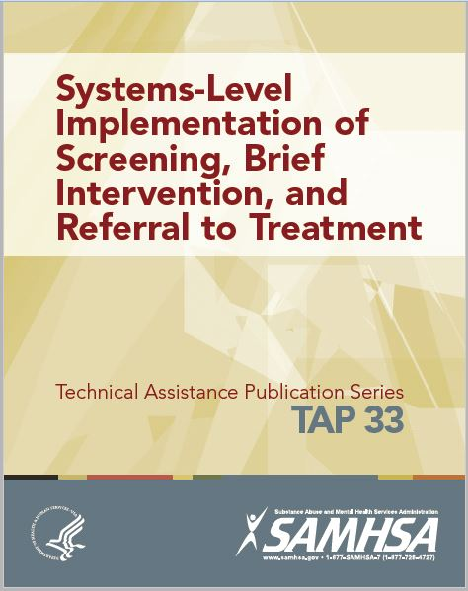
Content in this module is largely based on TAP 33, provided by SAMHSA
Notes:
We would like to acknowledge TAP 33 as the foundation of this training module.
Thank you for your time.

Slide 38
Acknowledgements

